Slide 1
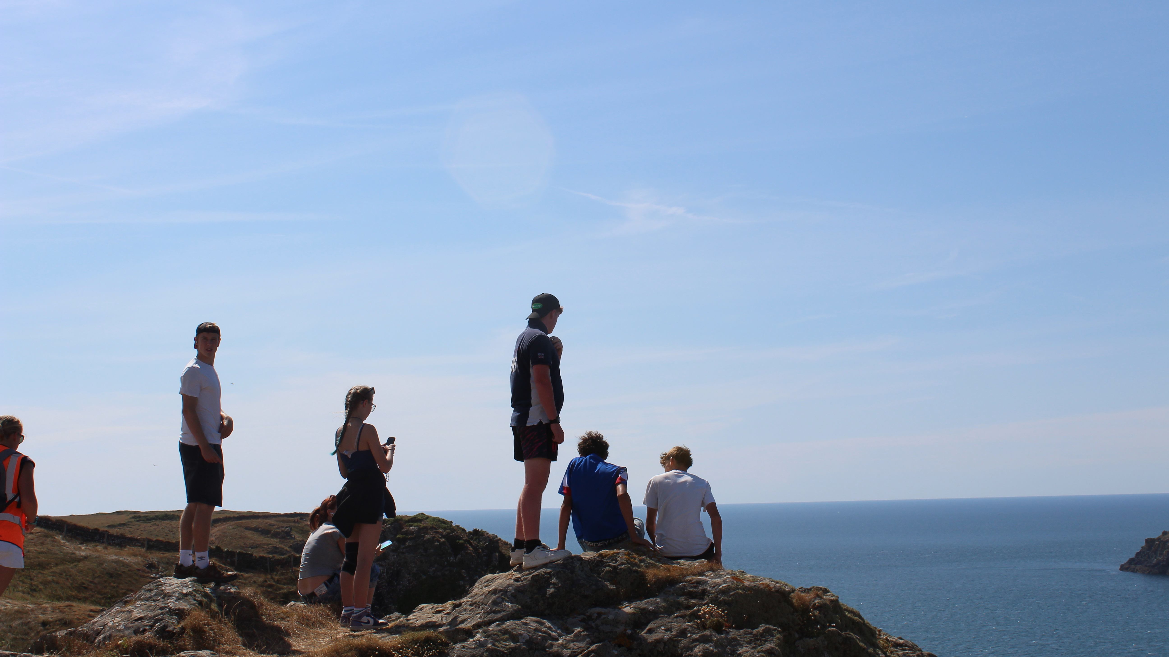


Slide 2
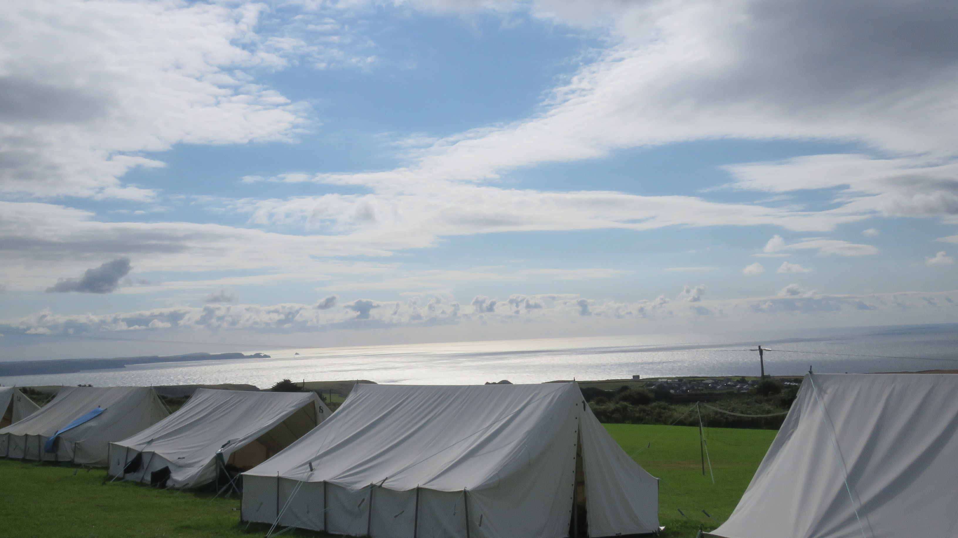
Our Vision
Our vision is to see children and young people come to a saving knowledge of Jesus Christ while at the same time, enjoying an action-packed holiday full of activities and friendship.

Slide 3
Discover | 31st July – 7th August | 12 – 14 yrs old (school yrs 7 - 9)

Slide 4
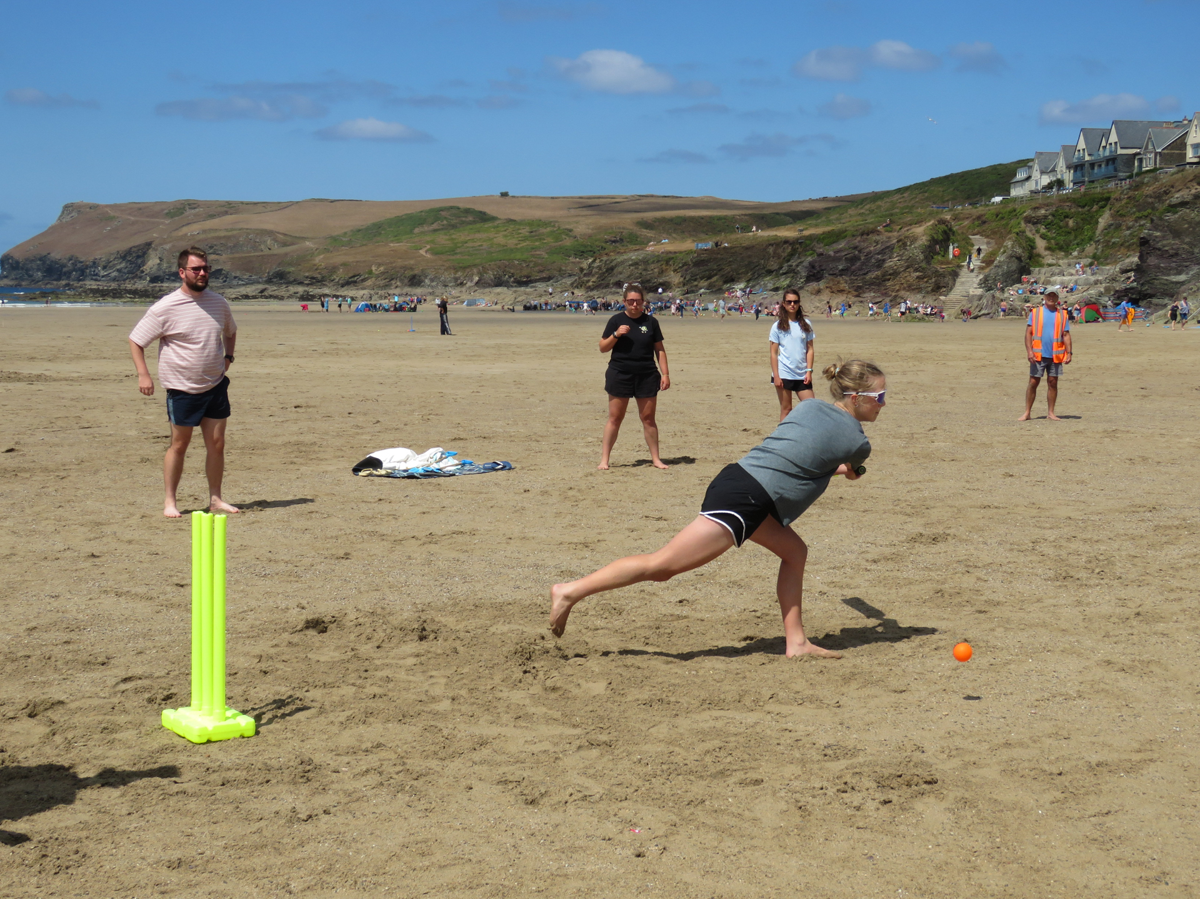

Slide 5
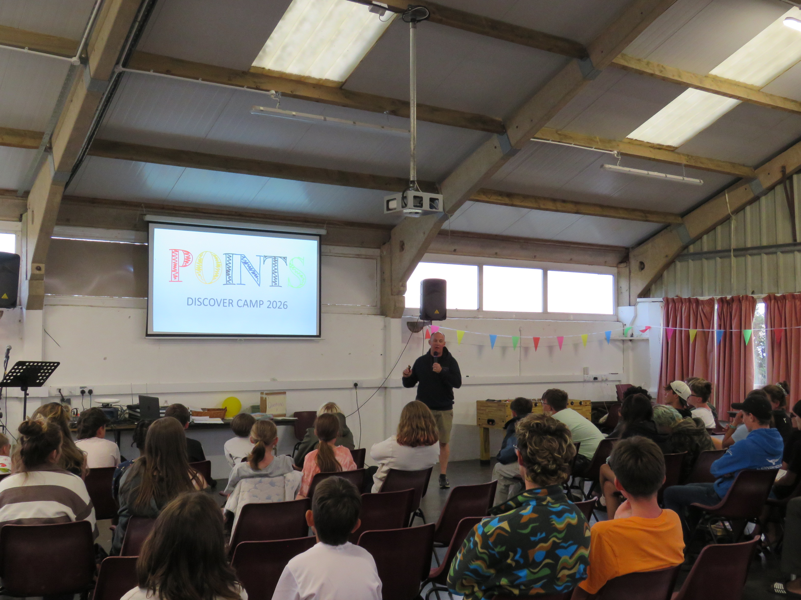

Slide 6
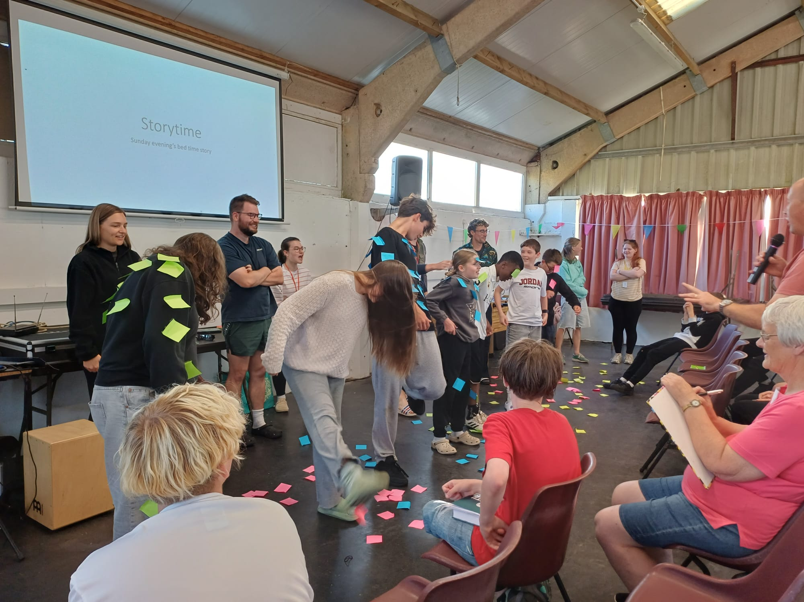

Slide 7
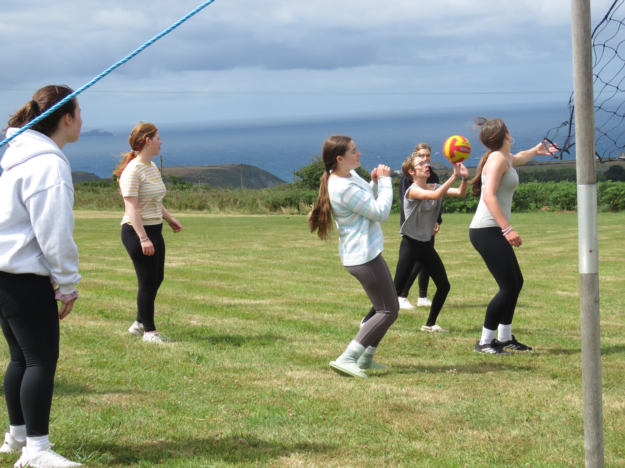

Slide 8



Slide 9
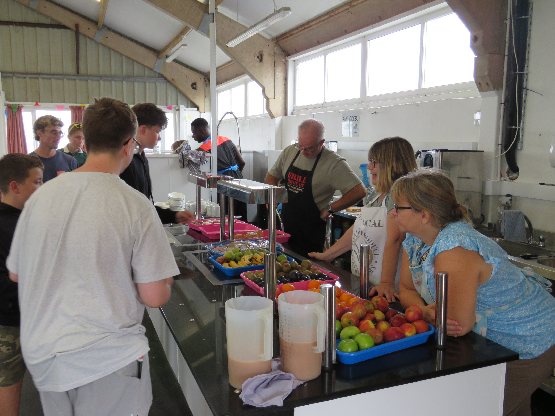

Slide 10
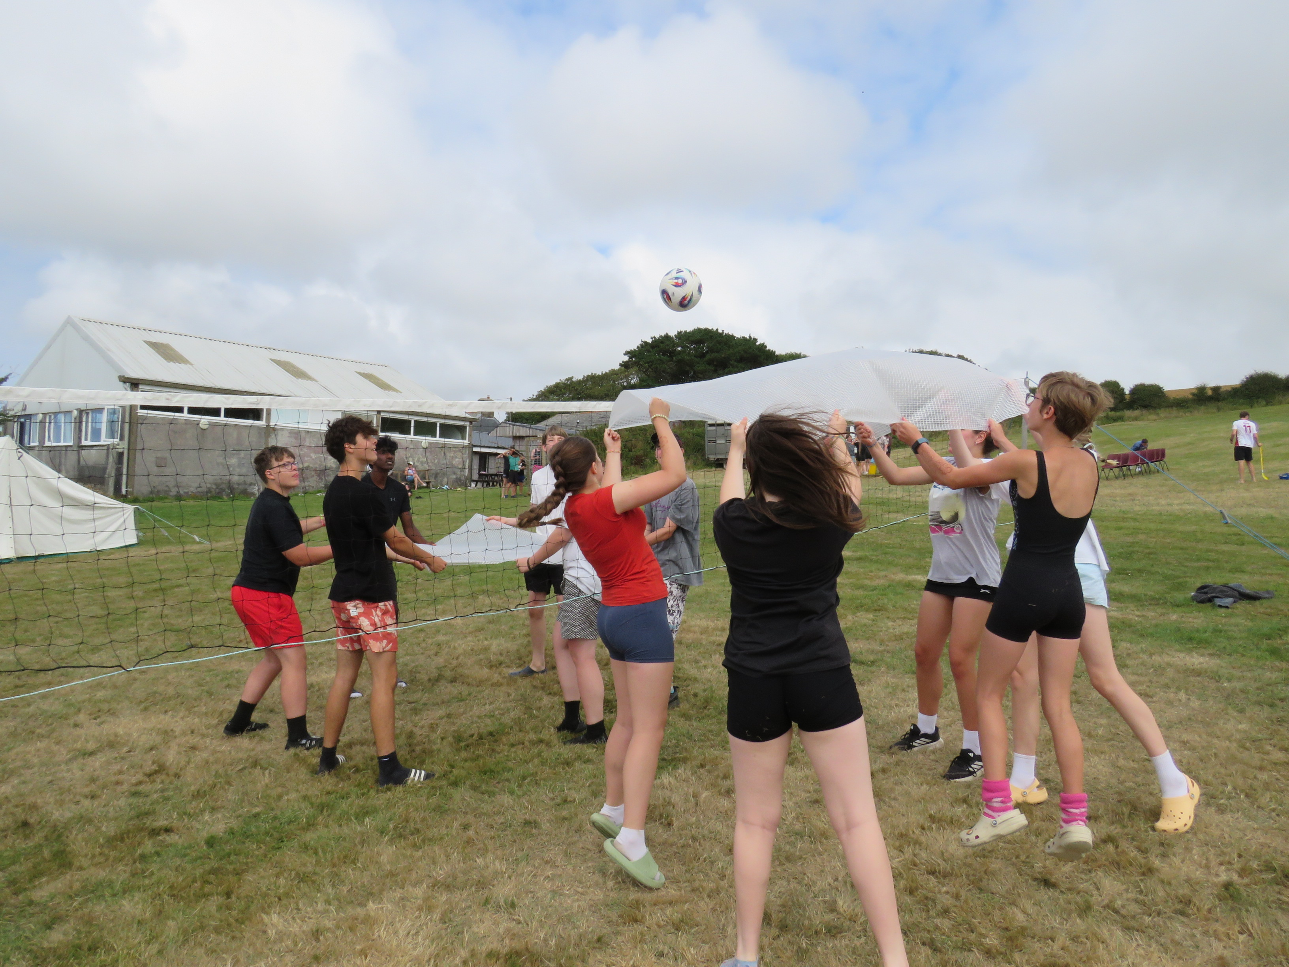

Slide 11
Discover | 31st July – 7th August | 12 – 14 yrs old (school yrs 7 - 9)
Equip | 7th August – 14th August | 15 – 17 yrs old (school yrs 10 - 12)

Slide 12
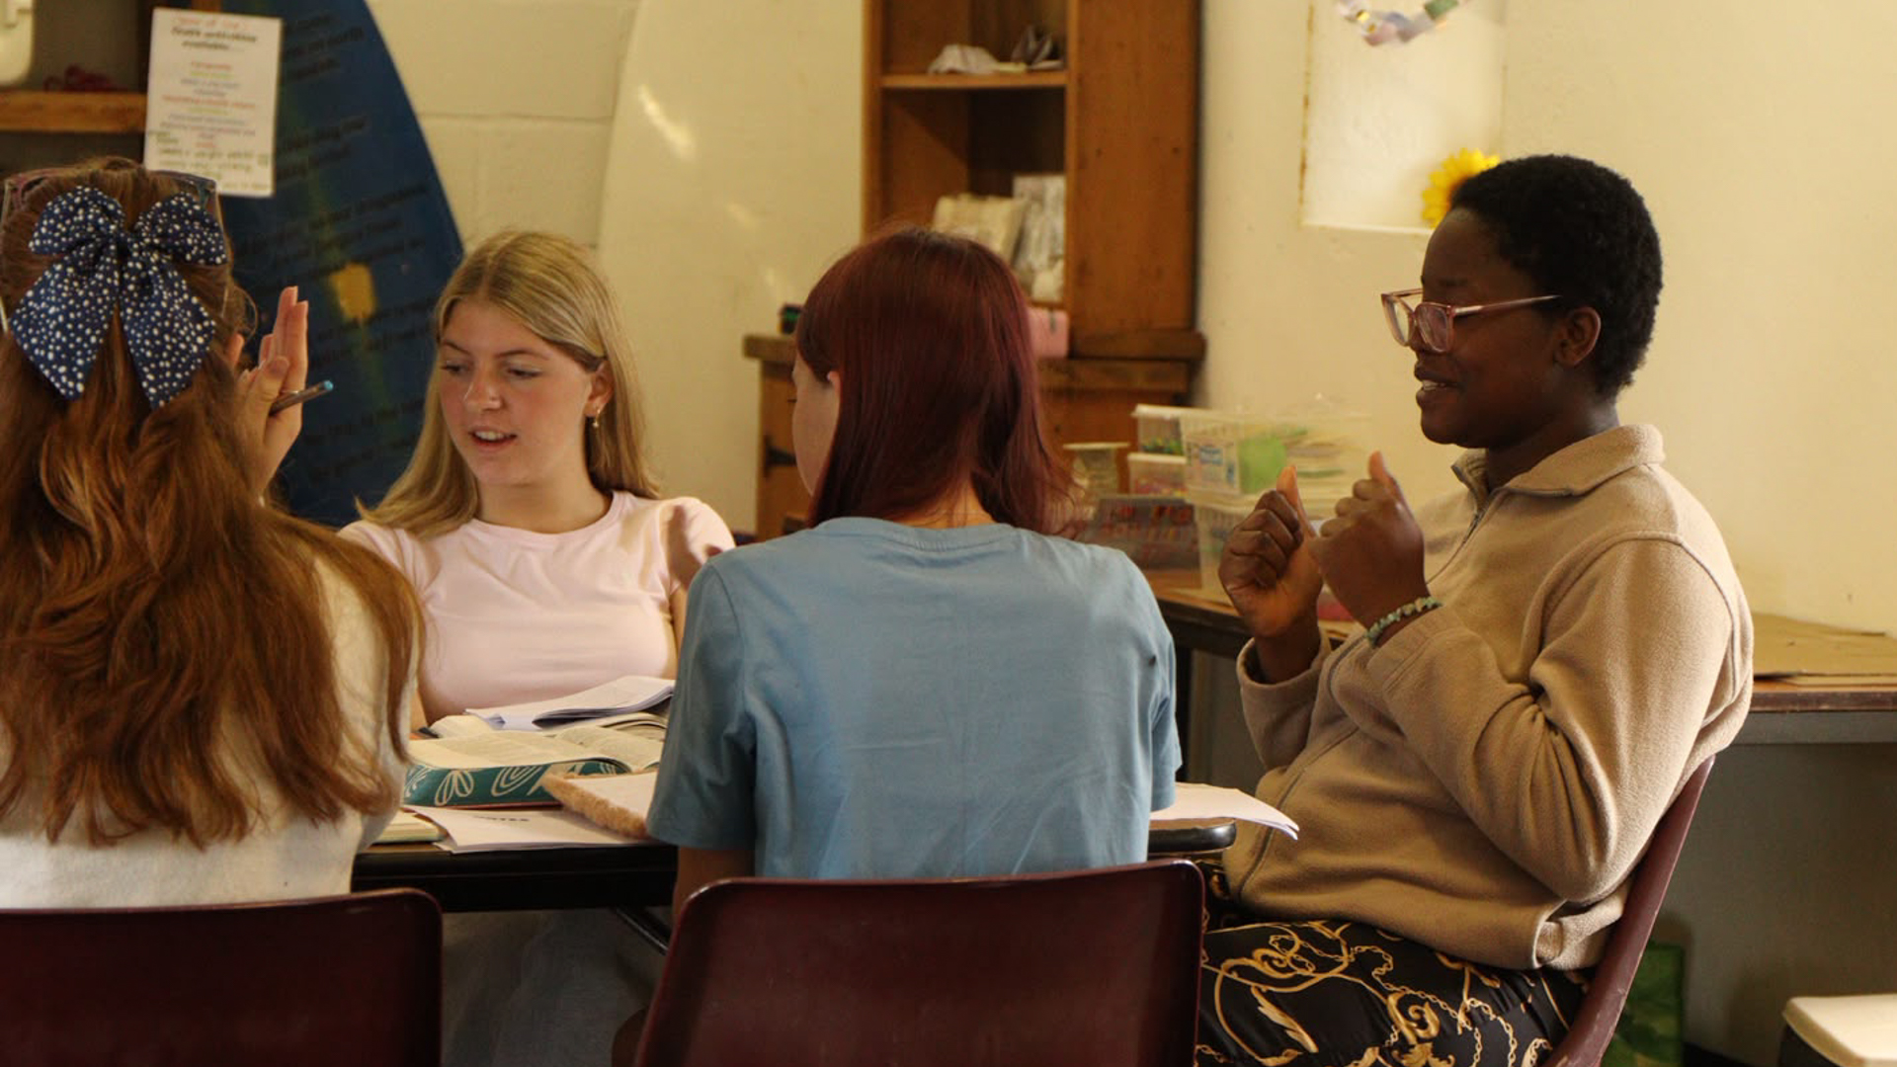

Slide 13
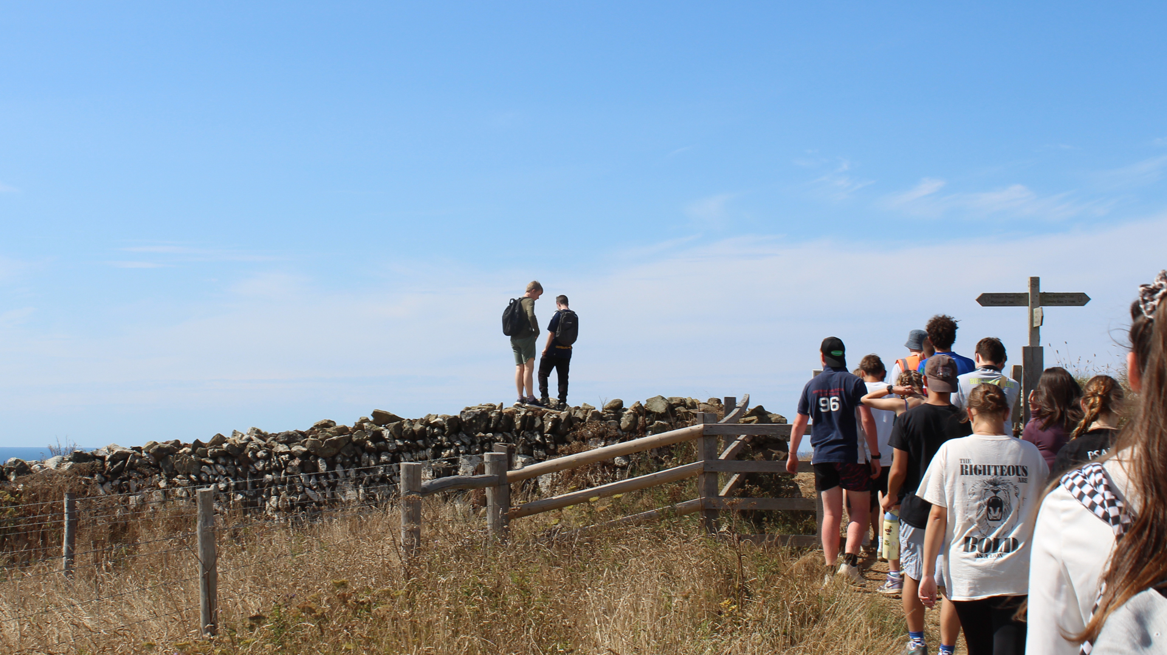

Slide 14
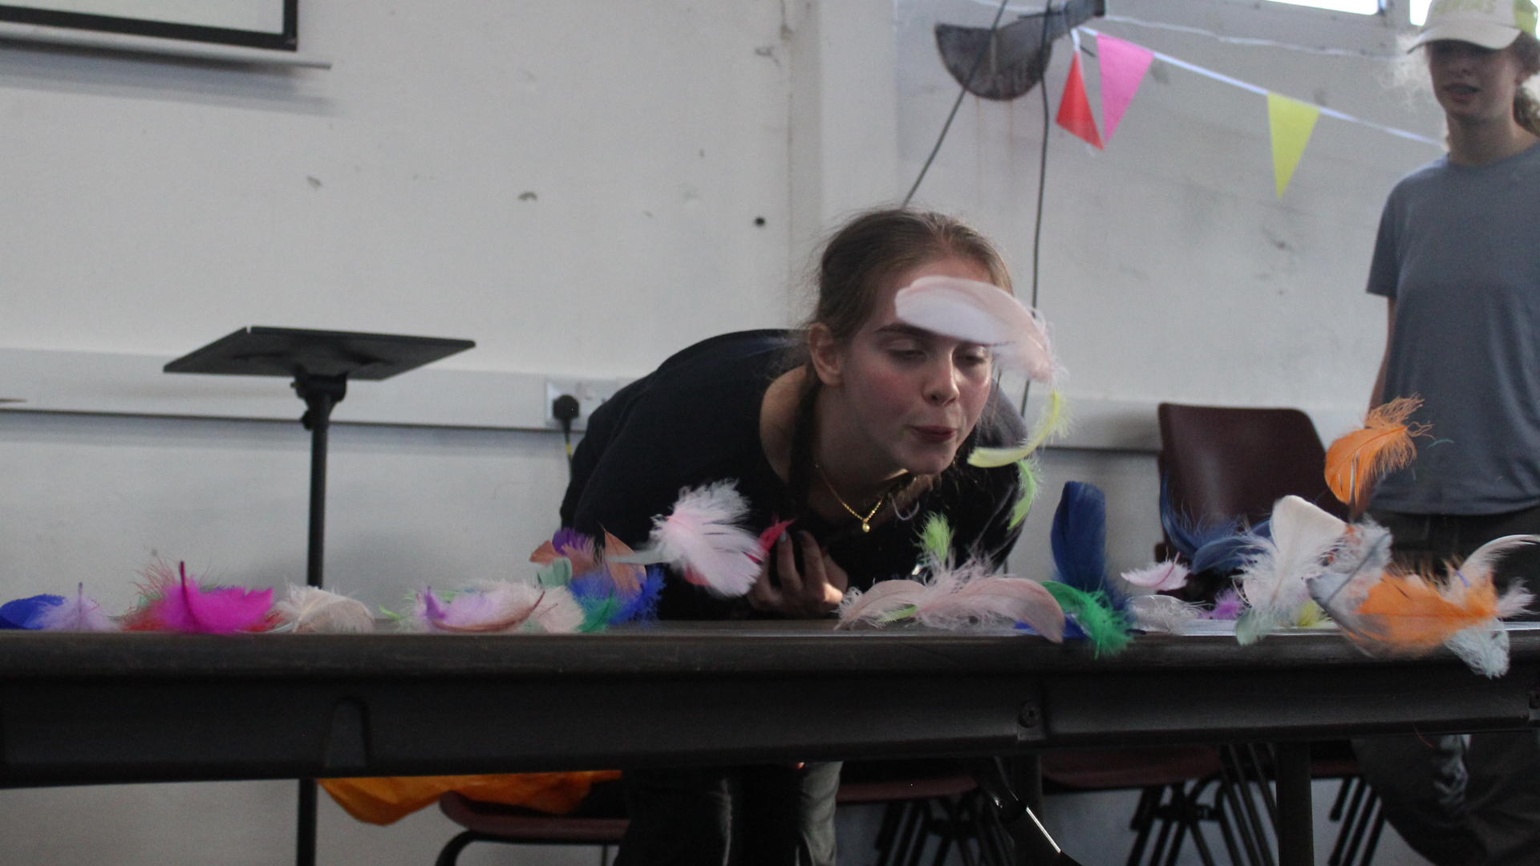

Slide 15
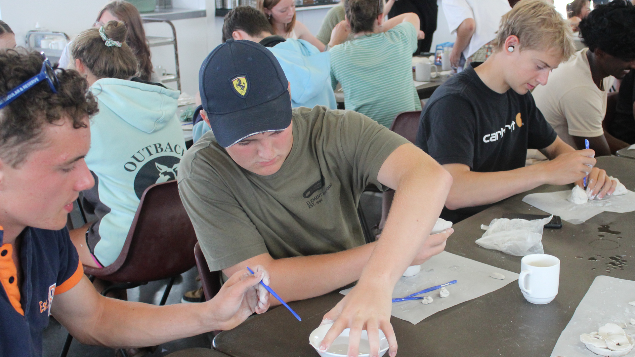

Slide 16
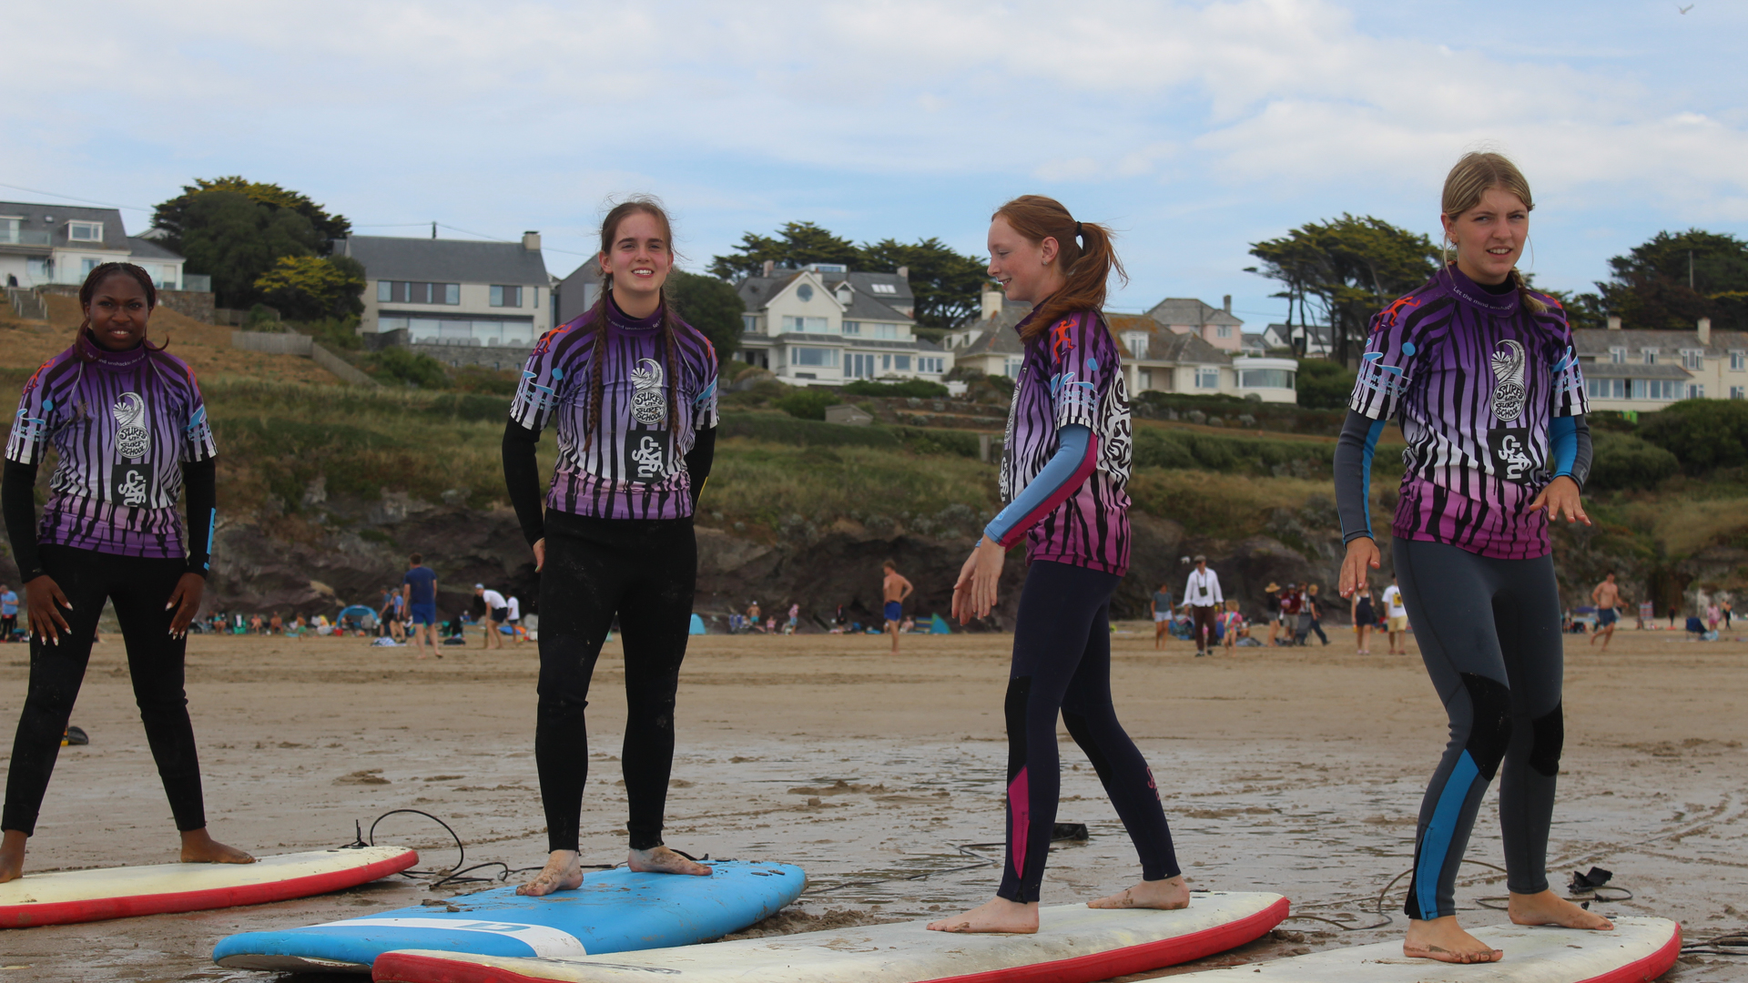

Slide 17
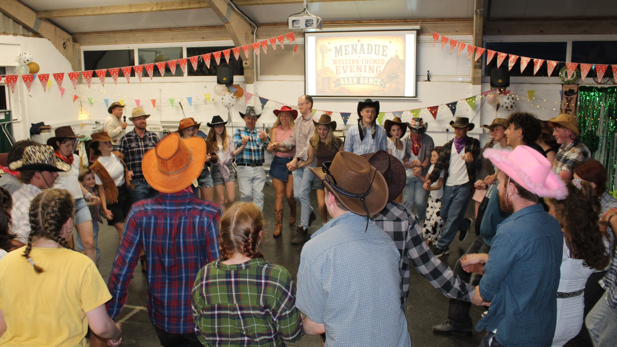

Slide 18
Discover | 21st July – 7th August | 12 – 14 yrs old (school yrs 7 - 9)
Equip | 7th August – 14th August | 15 – 17 yrs old (school yrs 10 - 12)
Explore | 14th August – 20th August | 9 - 11yrs old (school yrs 4 – 6)

Slide 19
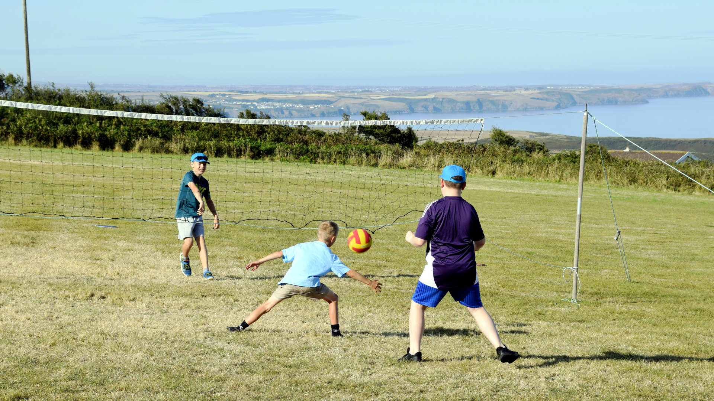

Slide 20
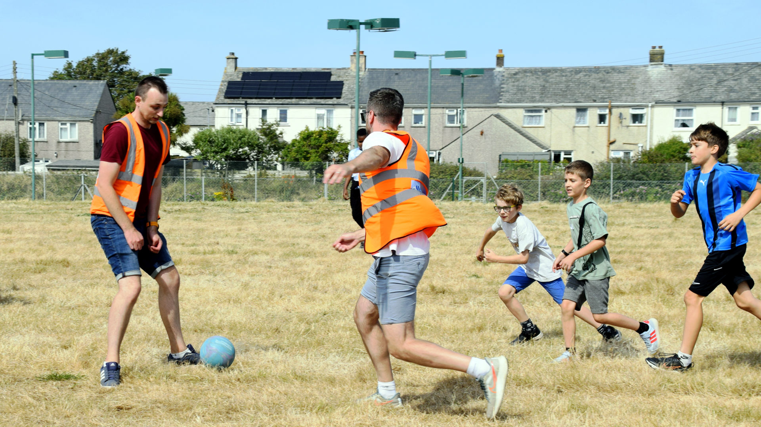

Slide 21
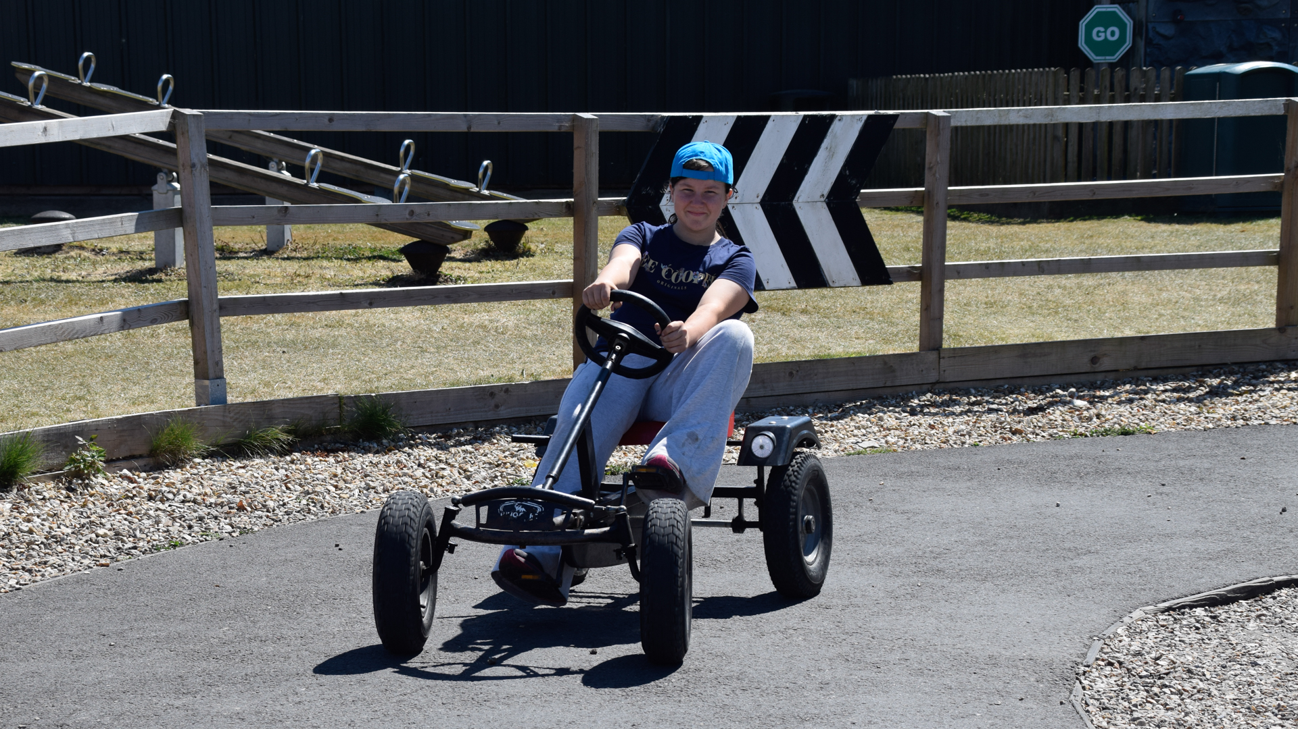

Slide 22
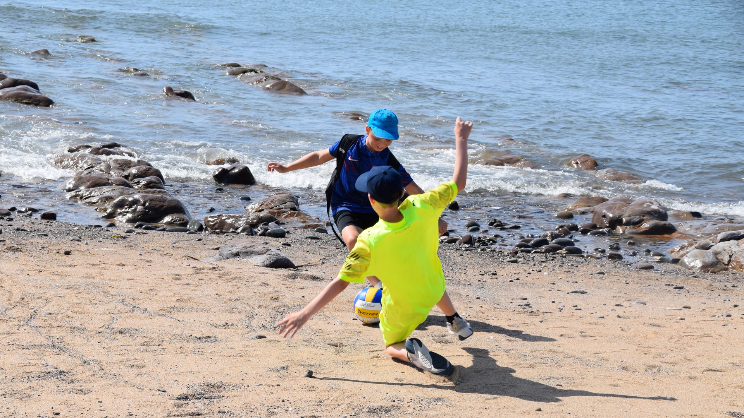

Slide 23
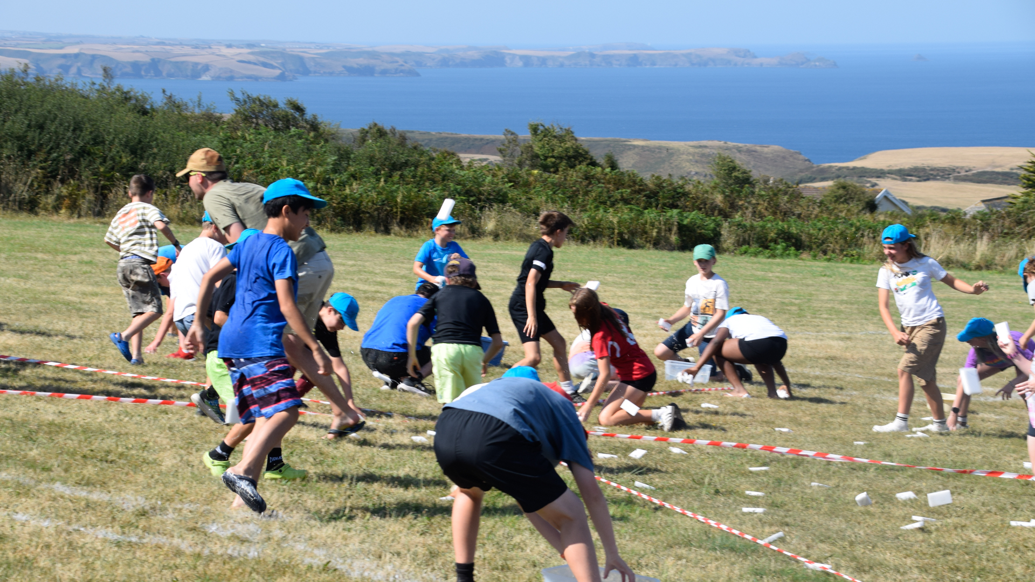

Slide 24
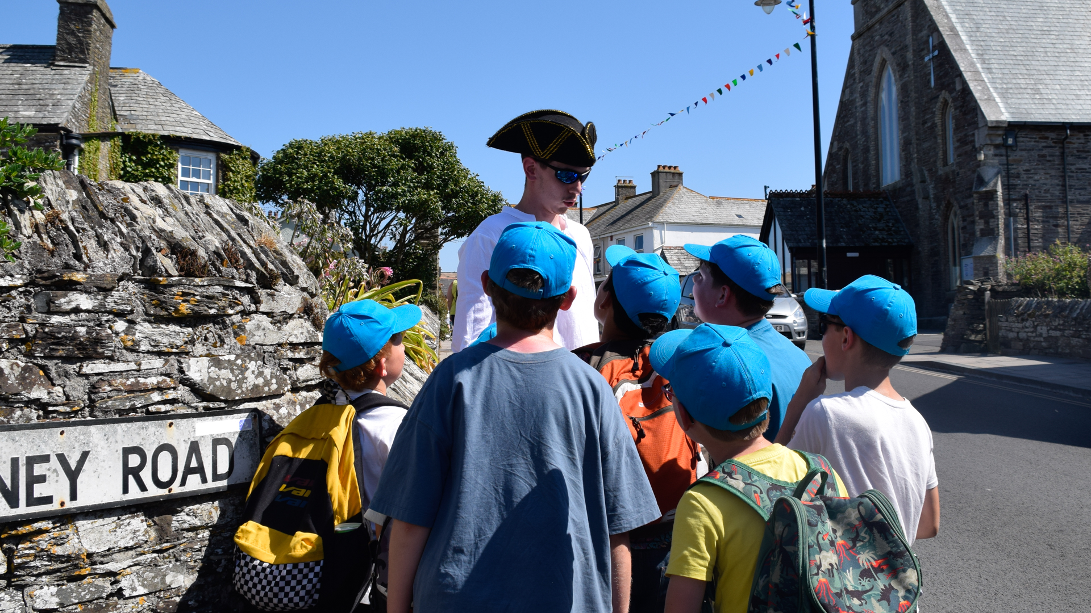

Slide 25
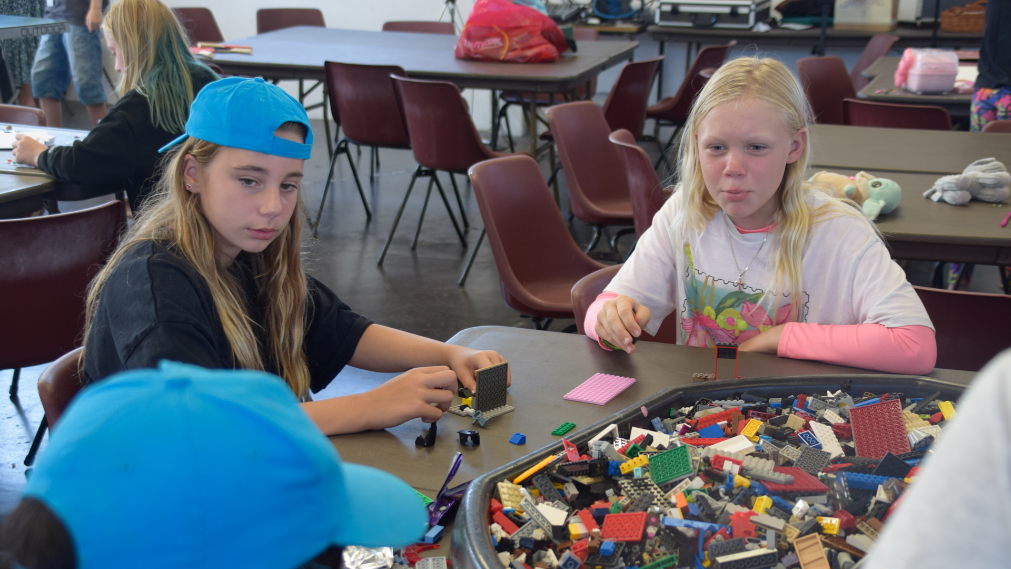

Slide 26
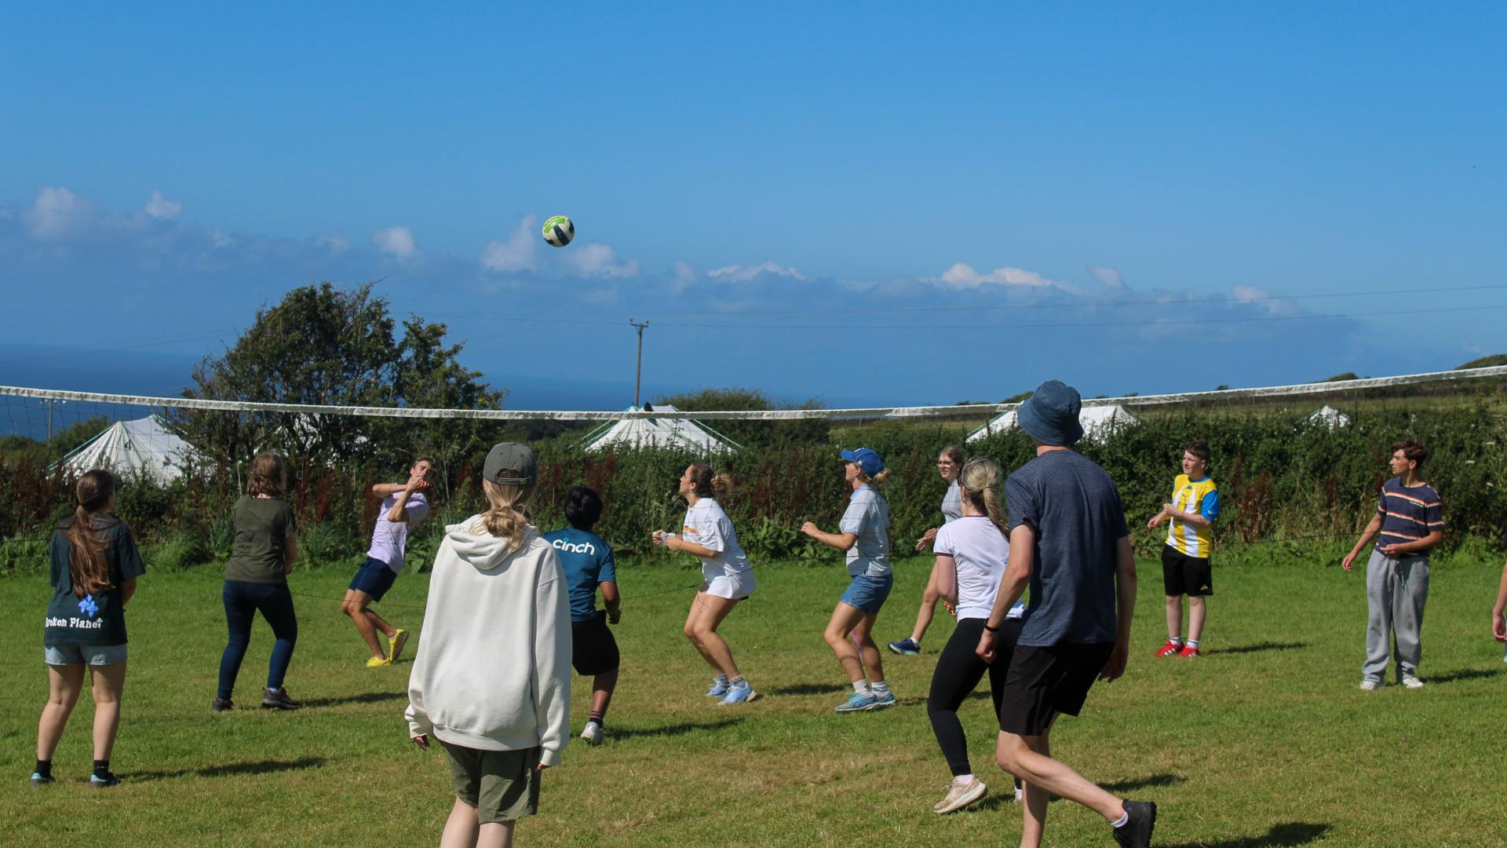
Click here
for video

Slide 27

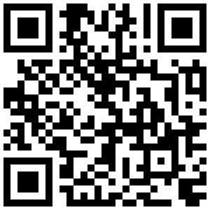

Equip & Discover: £165
£180 with £15 deposit before 31 Dec 2025
Explore: £140
£125 with £15 deposit before 31 Dec 2025

