Slide 1
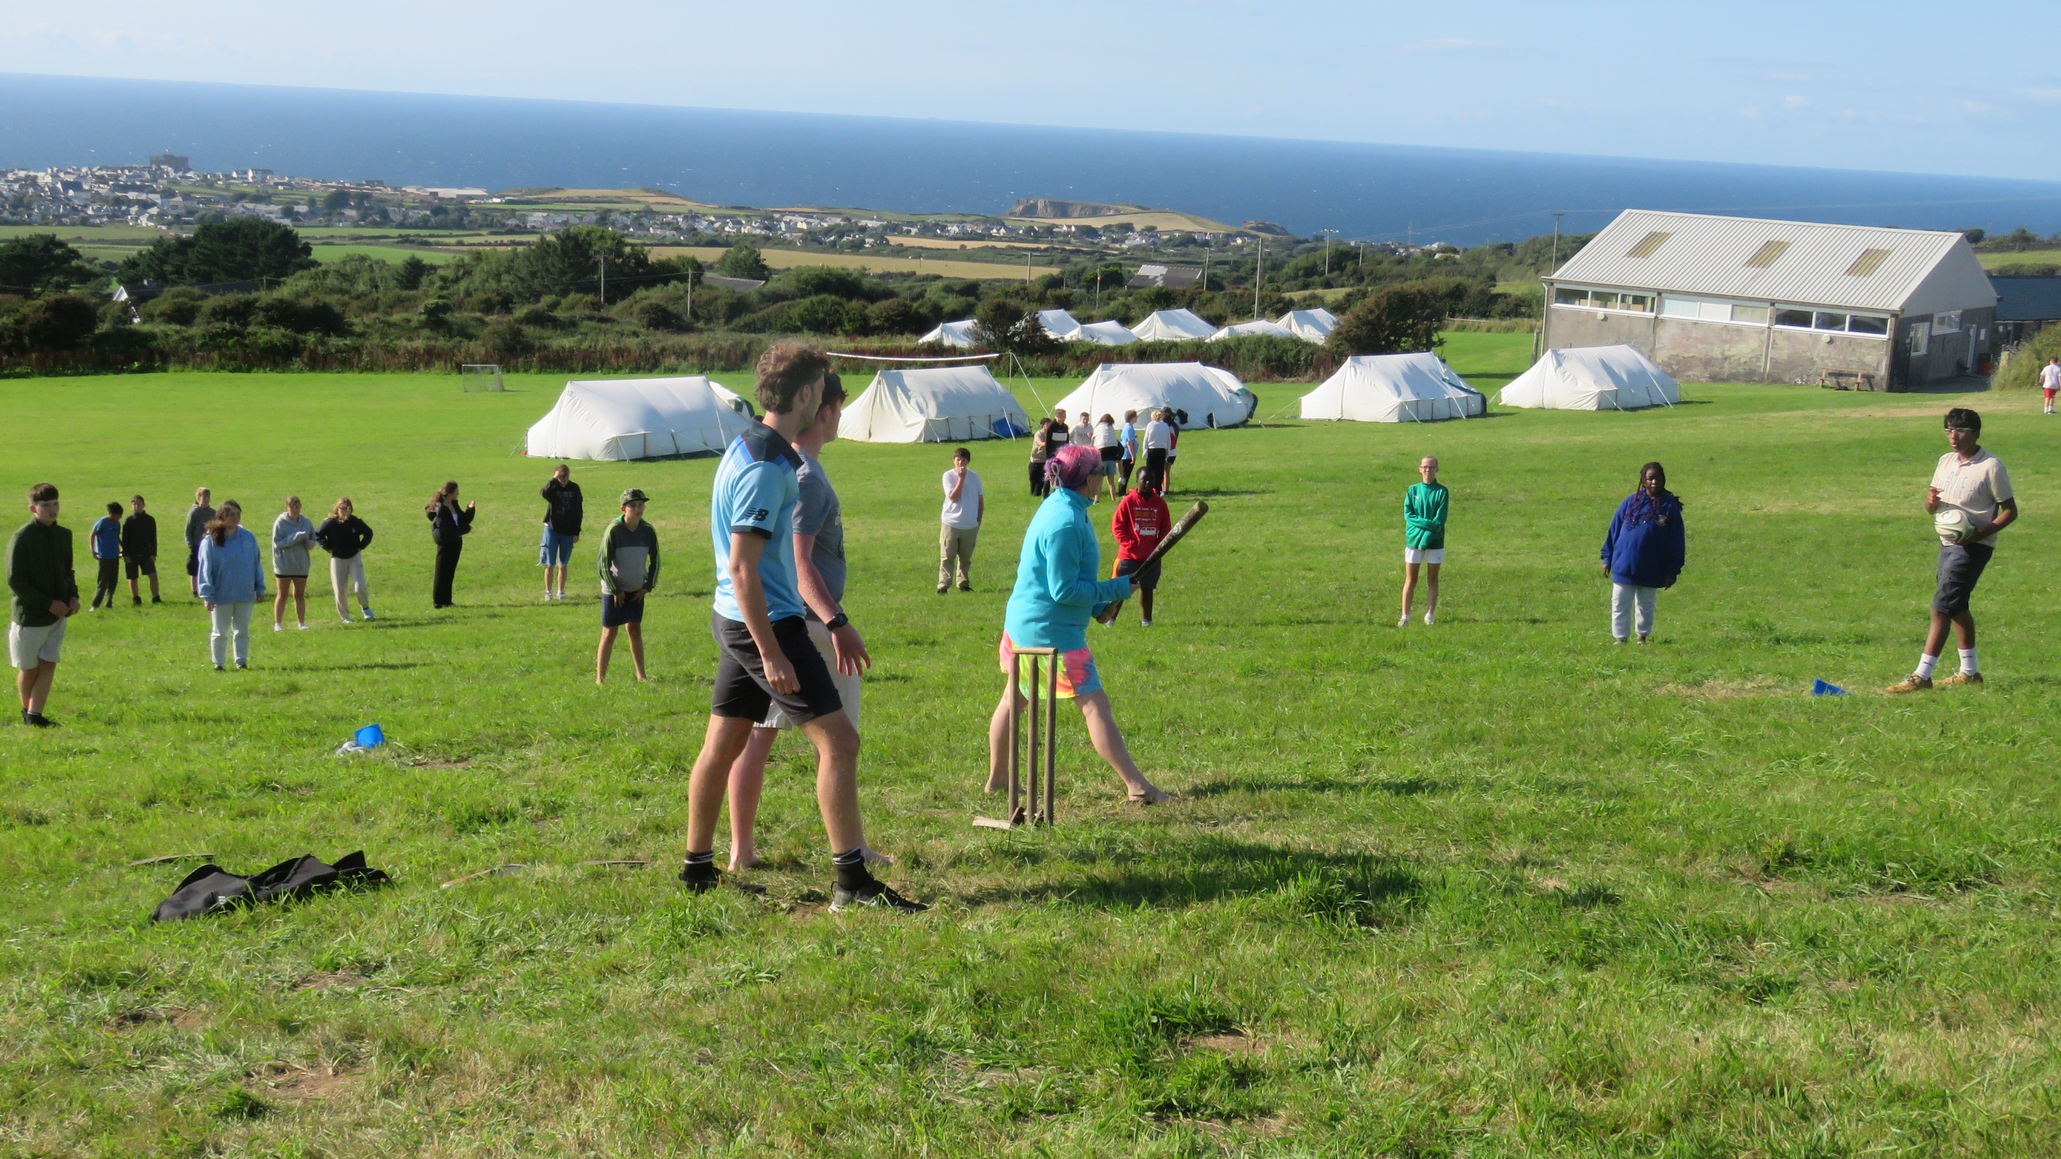


Slide 2
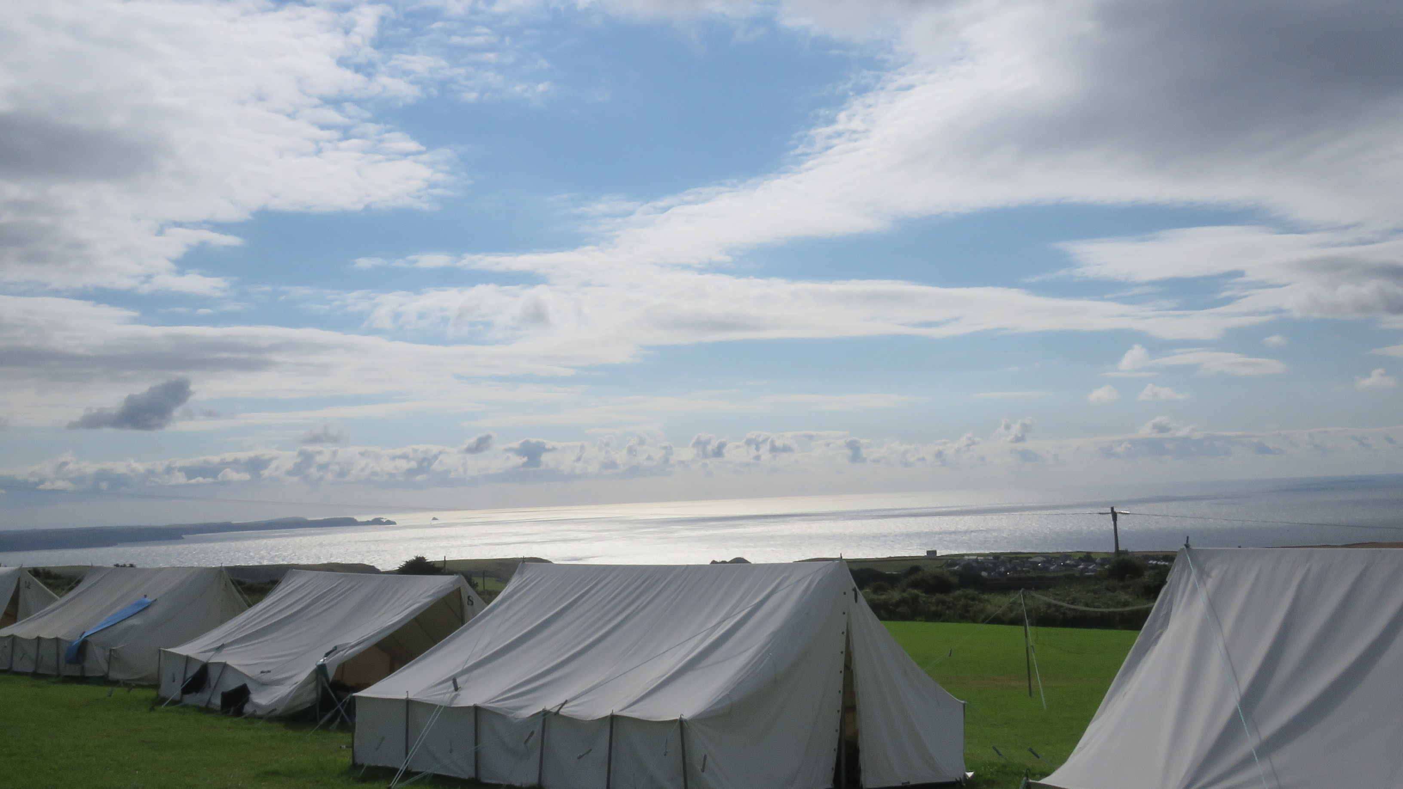
Our Vision
Our vision is to see children and young people come to a saving knowledge of Jesus Christ while at the same time, enjoying an action-packed holiday full of activities and friendship.

Slide 3
Discover | 25th July – 1st August | 12 – 14 yrs old (school yrs 7 - 9)

Slide 4
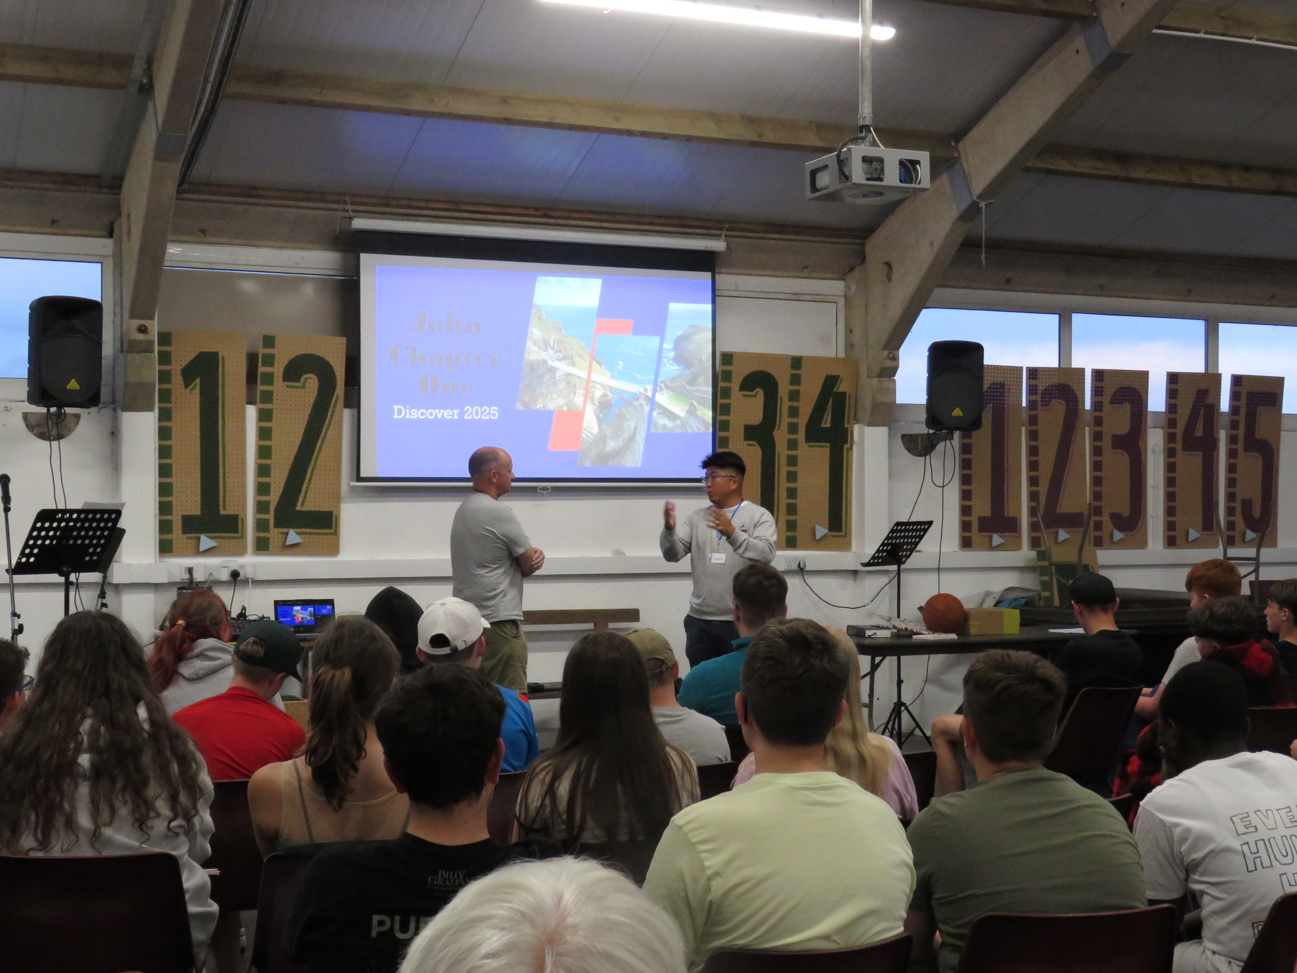

Slide 5
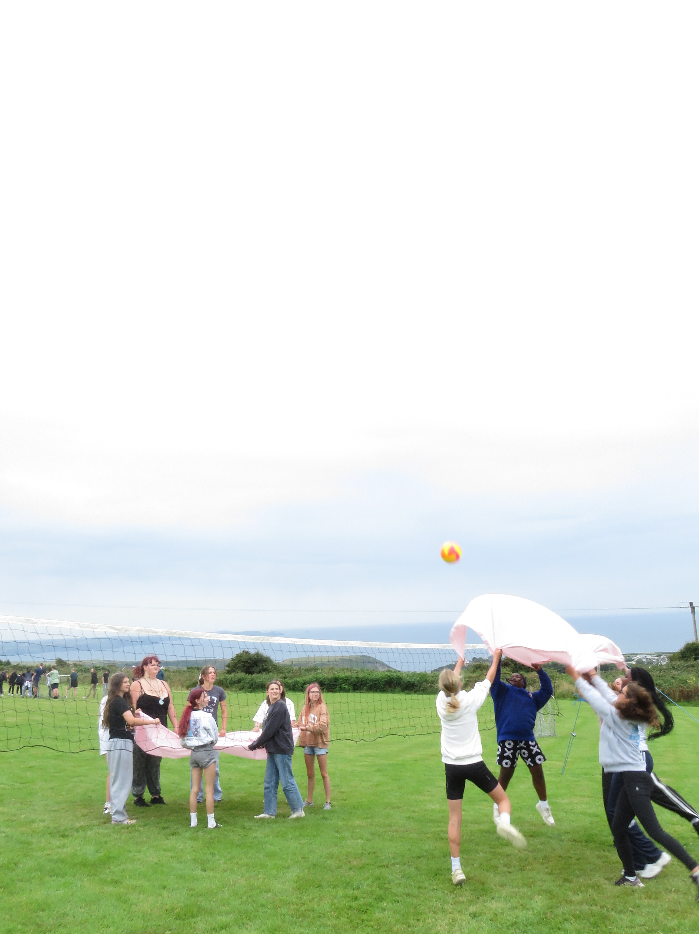

Slide 6
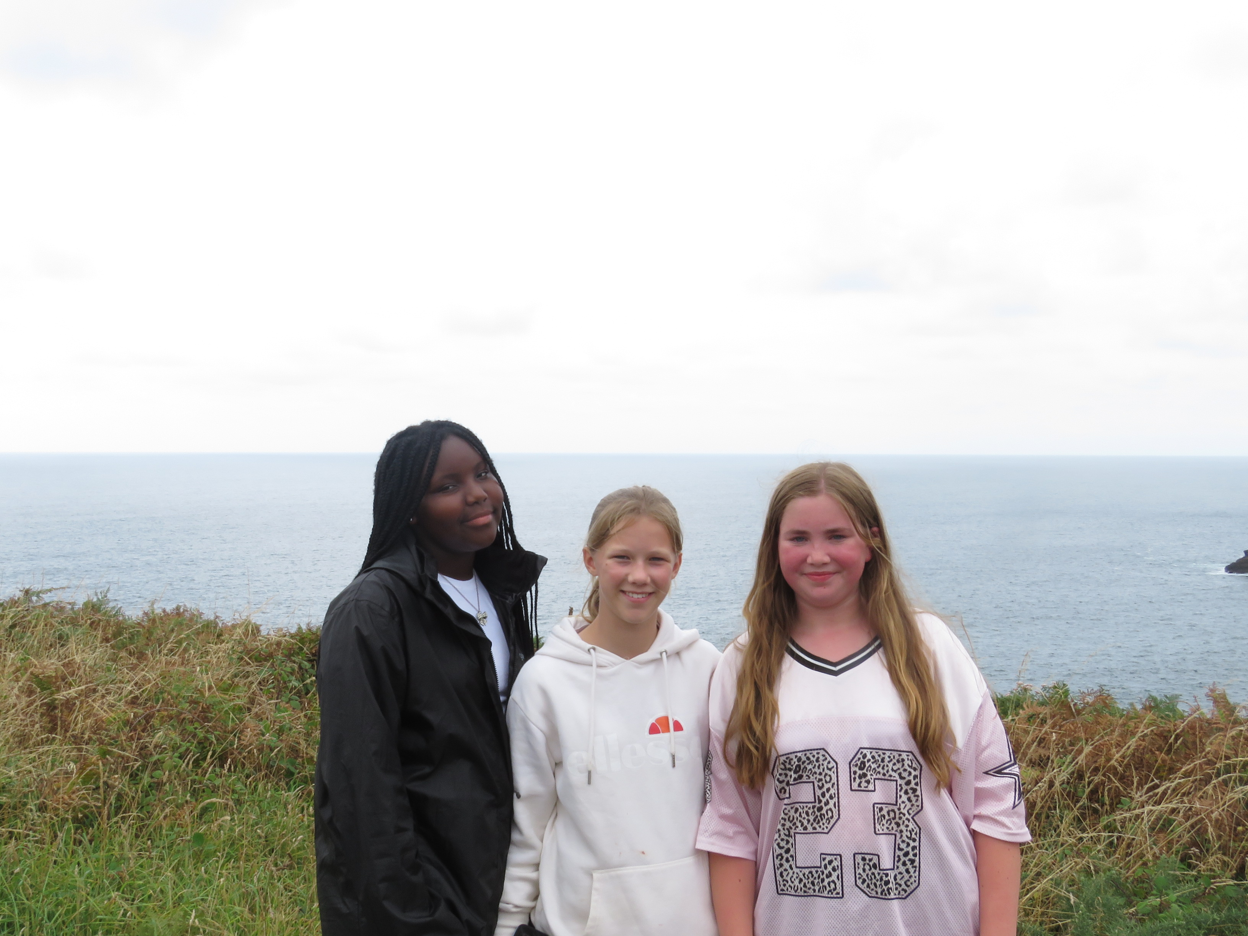

Slide 7
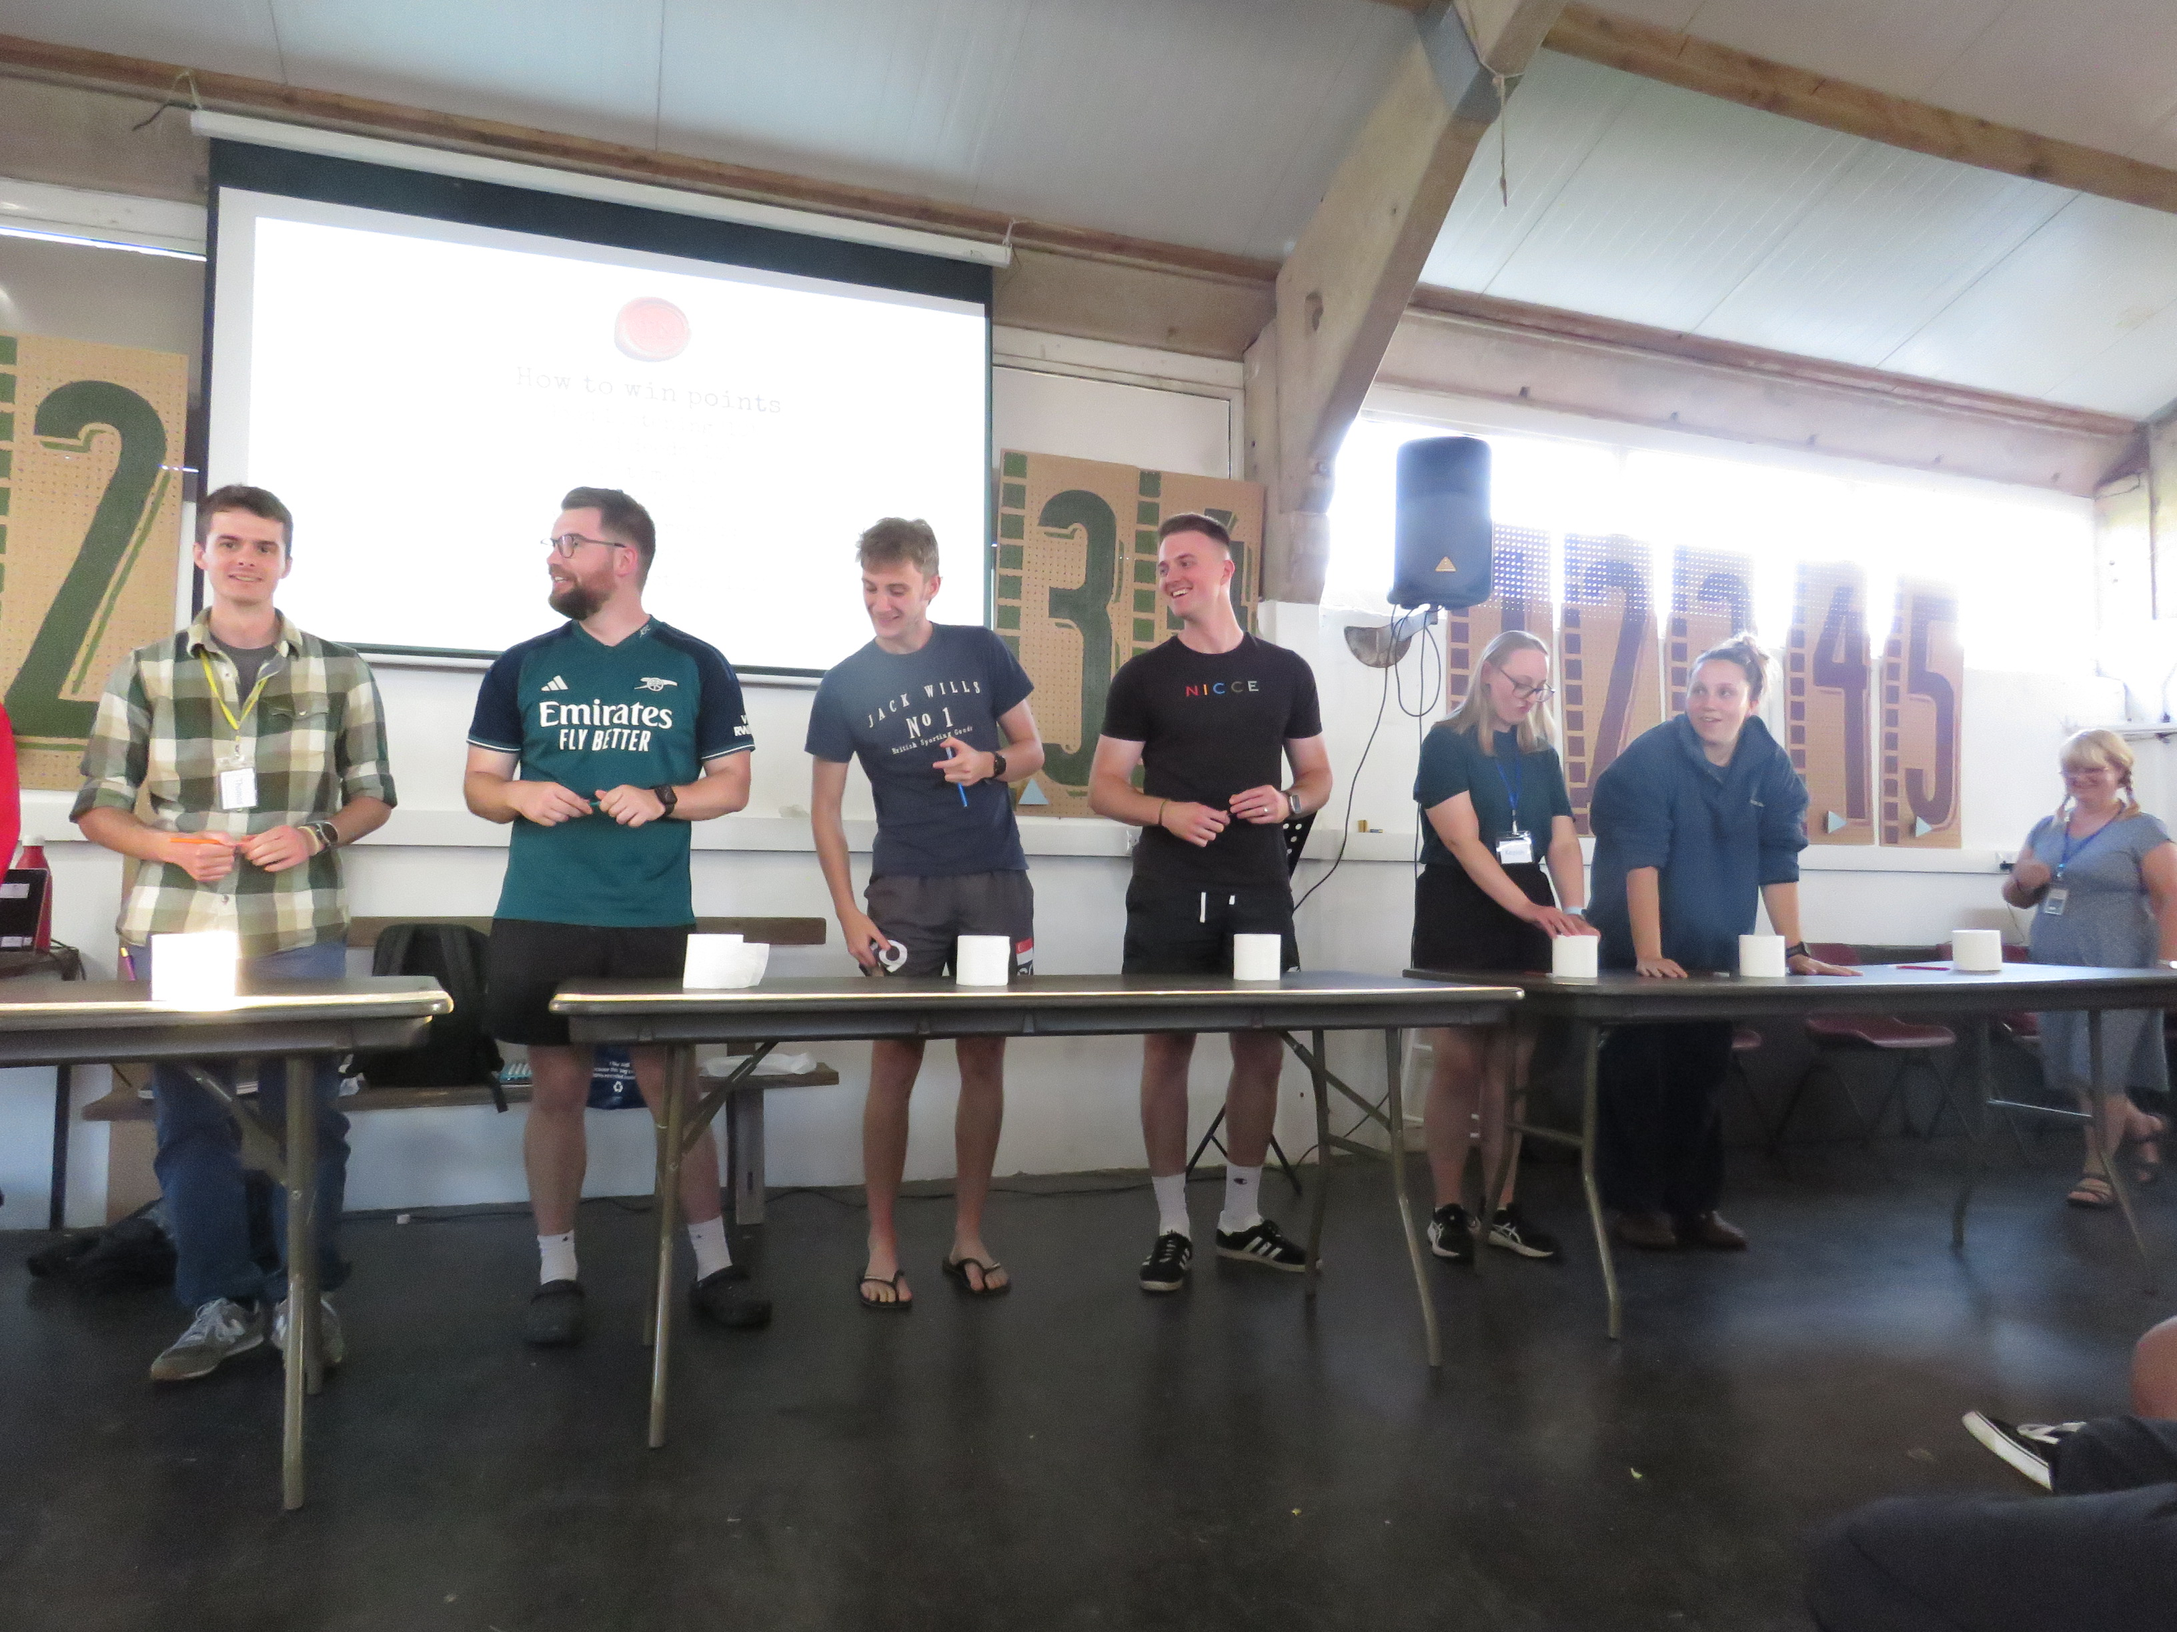

Slide 8
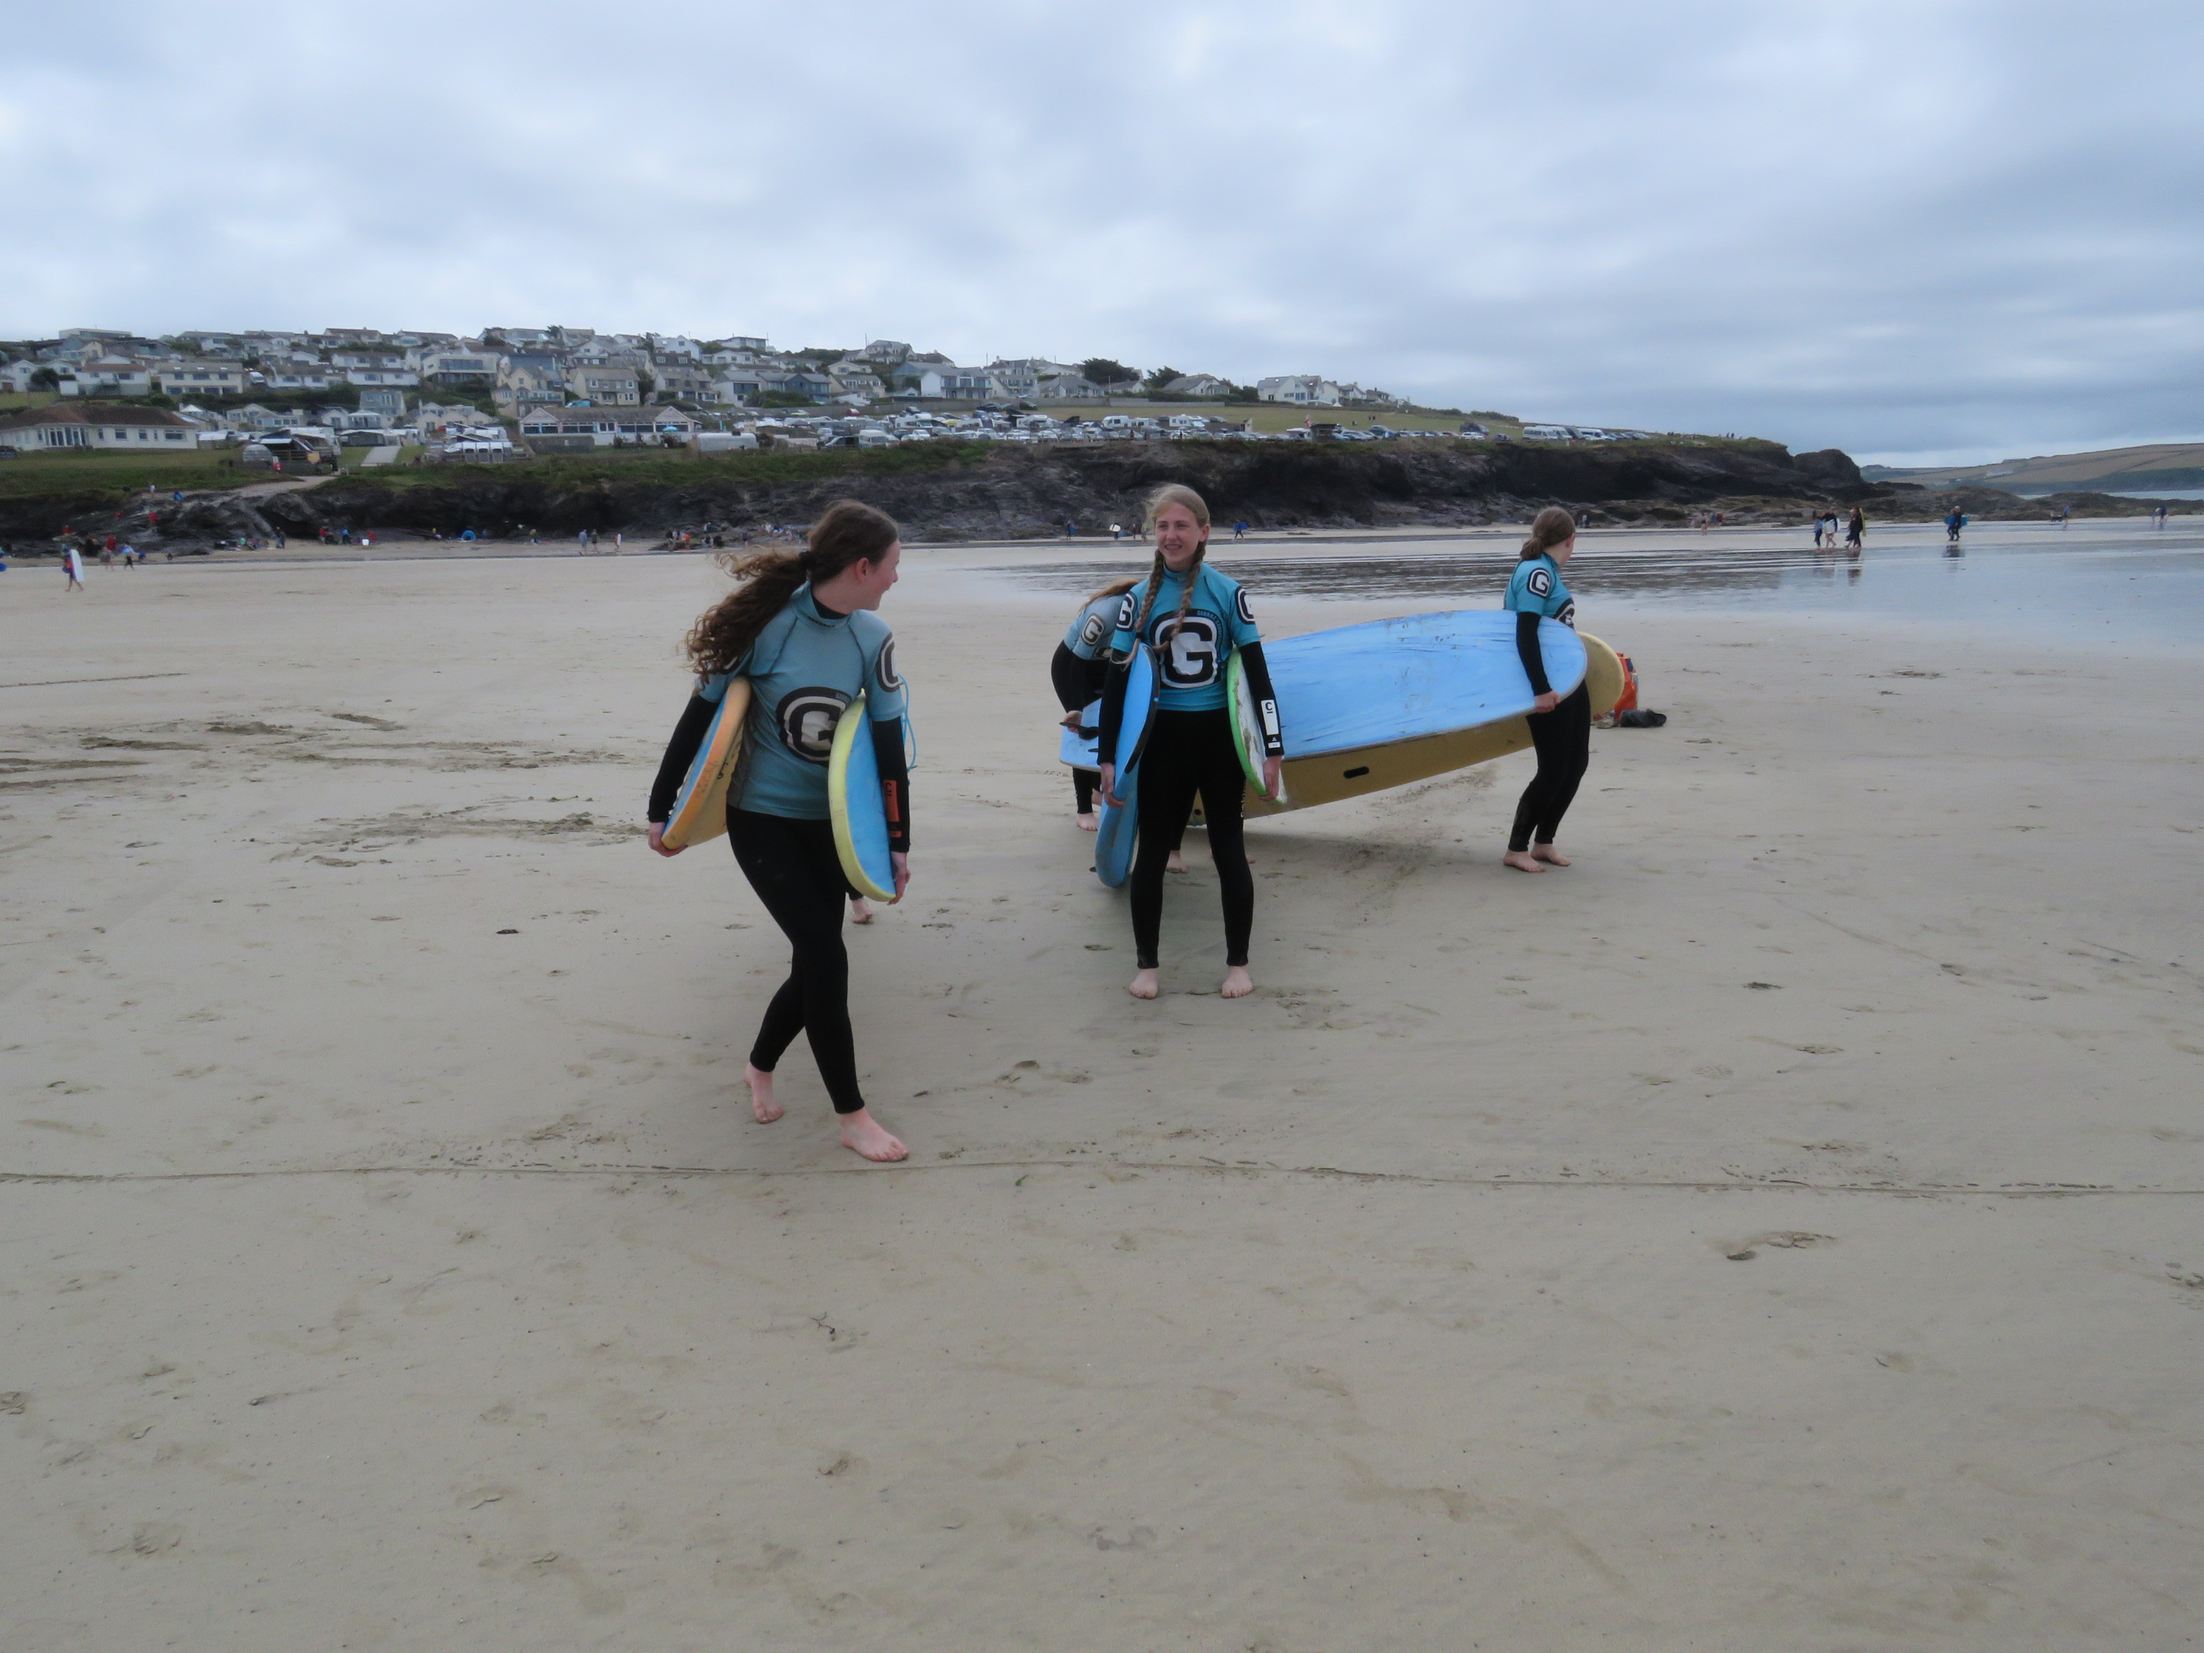

Slide 9
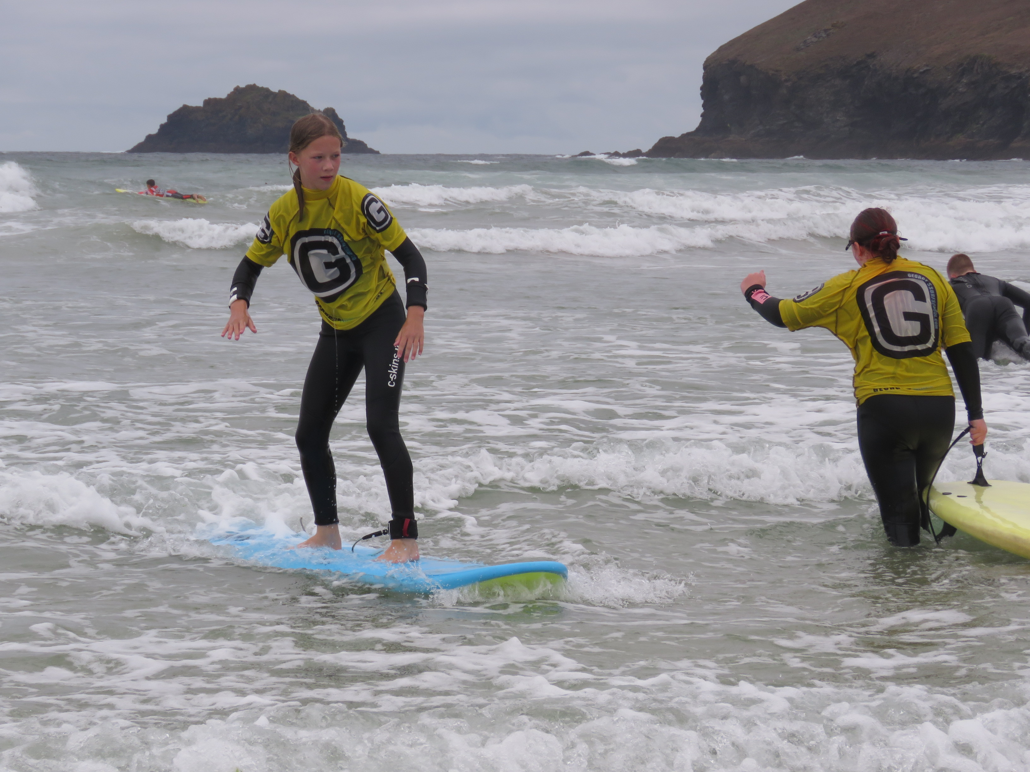

Slide 10
Discover | 25th July – 1st August | 12 – 14 yrs old (school yrs 7 - 9)
Equip | 1st August – 8th August | 15 – 17 yrs old (school yrs 10 - 12)

Slide 11
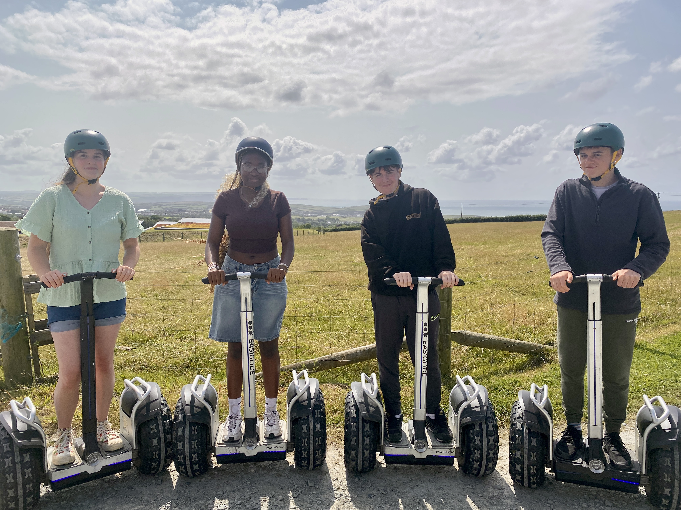

Slide 12
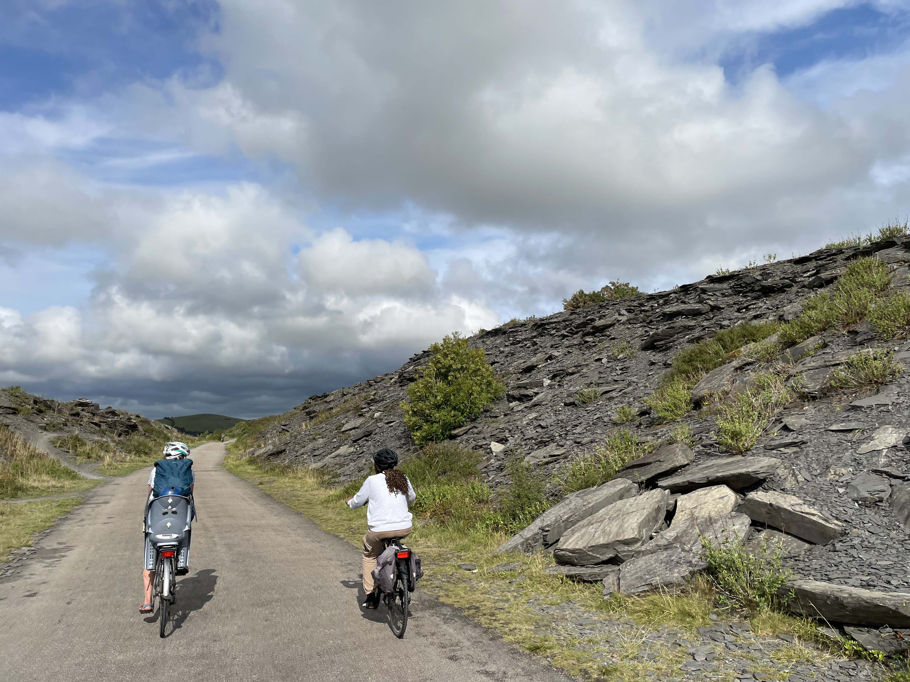

Slide 13
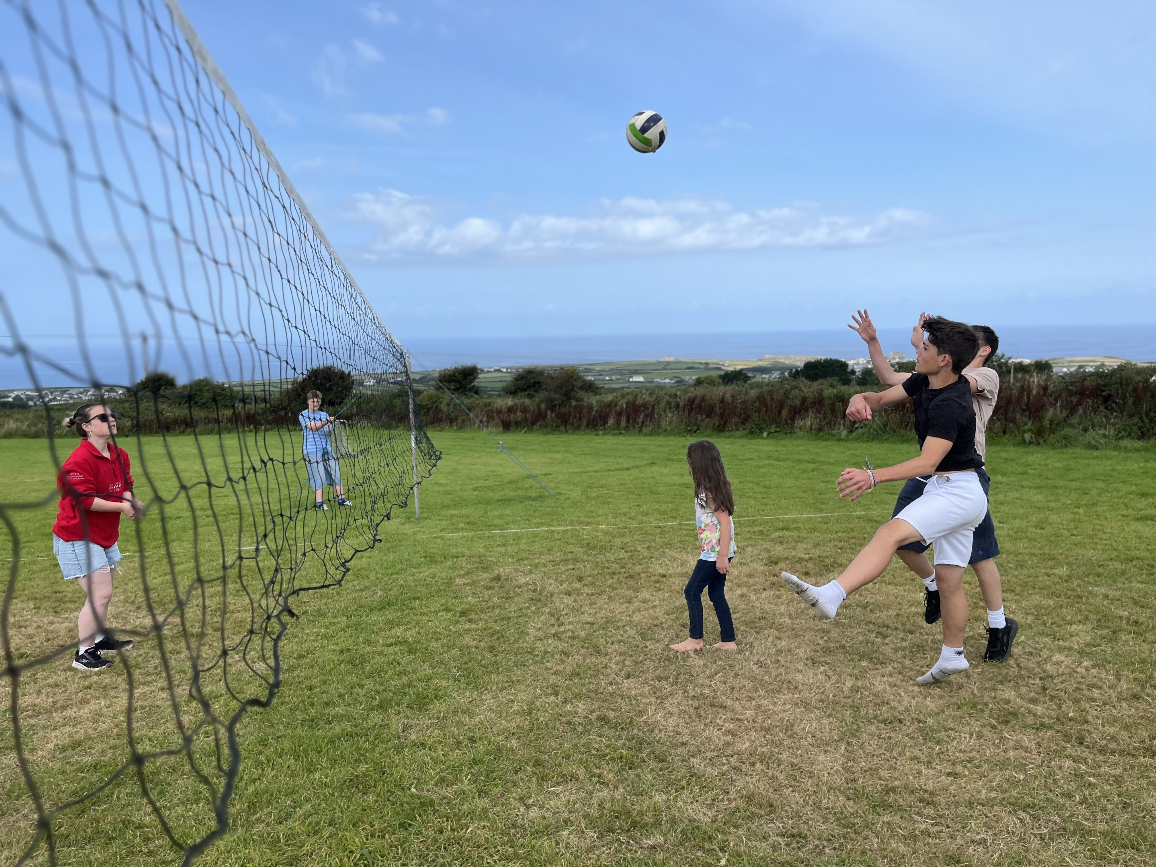

Slide 14
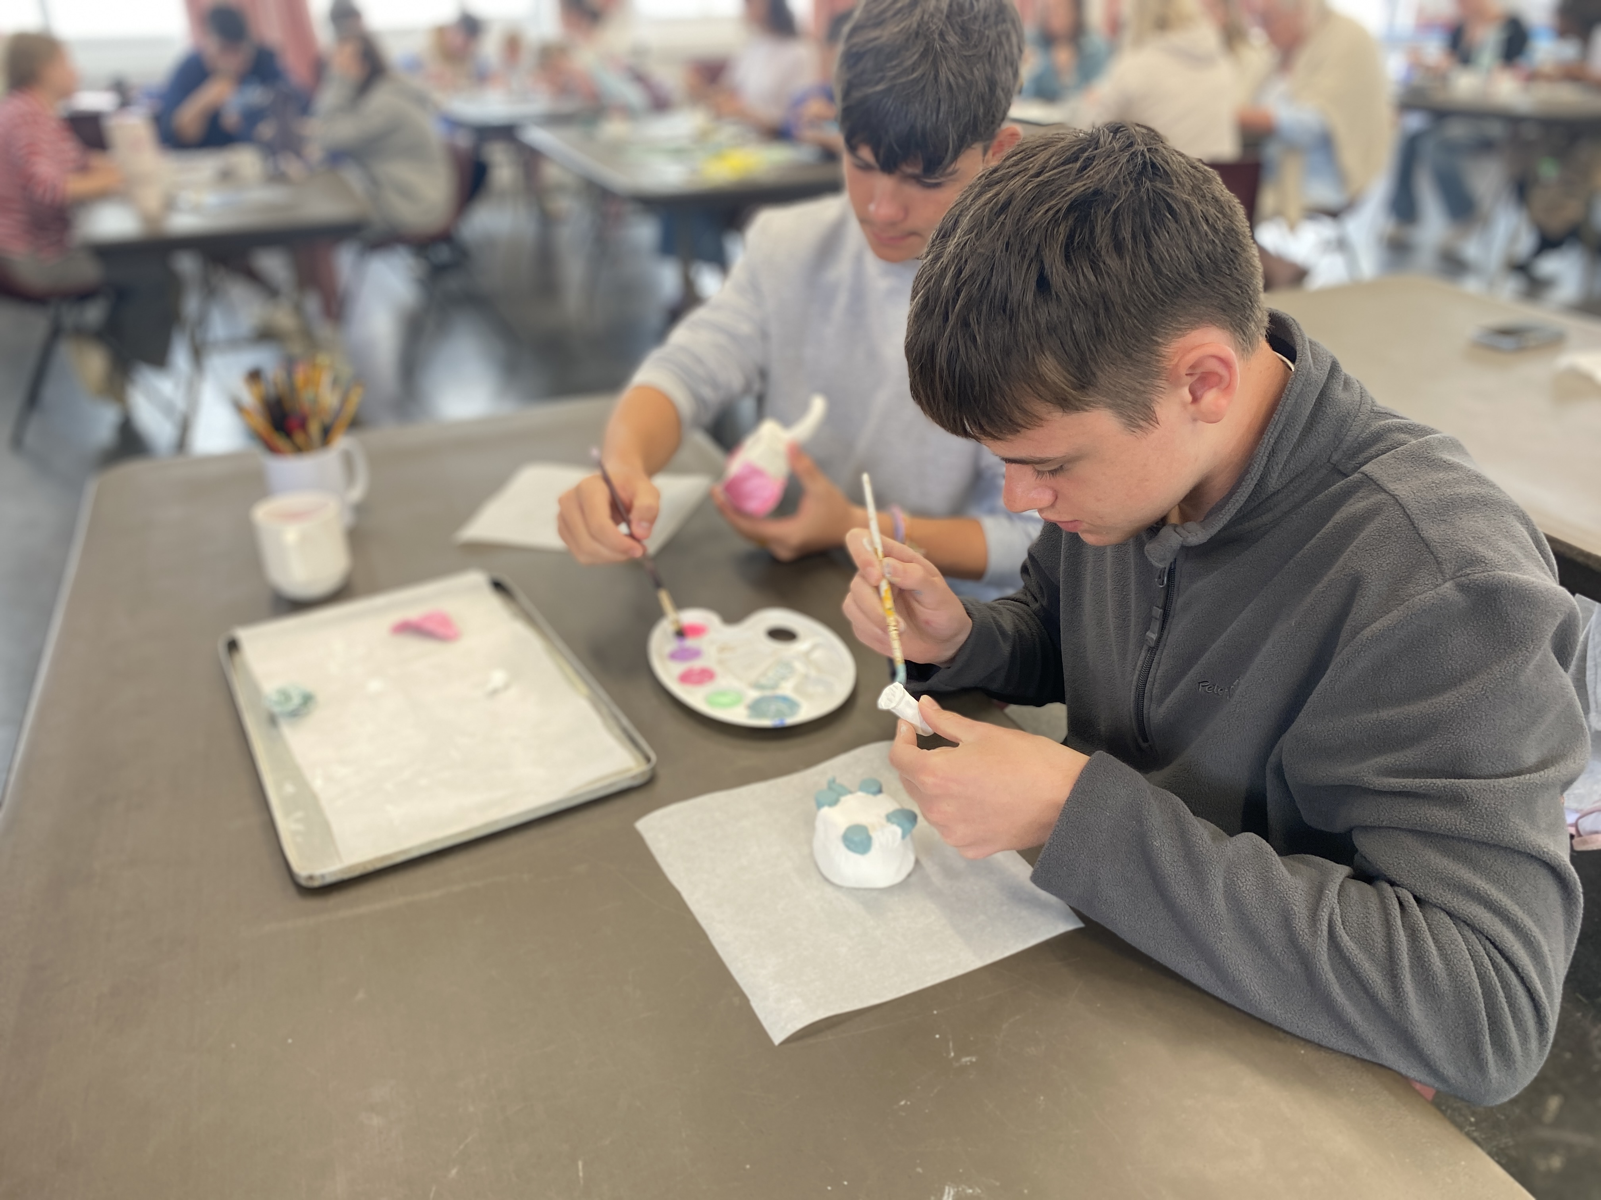

Slide 15
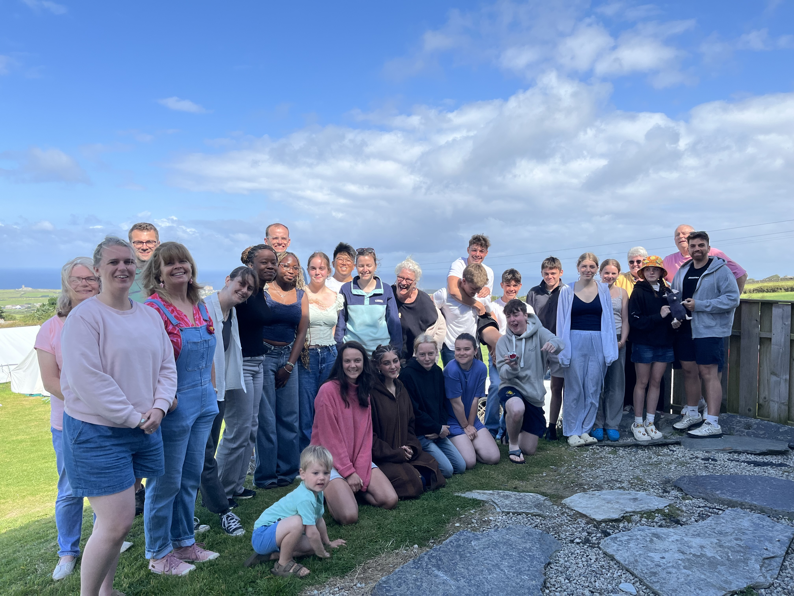

Slide 16
Discover | 25th July – 1st August | 12 – 14 yrs old (school yrs 7 - 9)
Equip | 1st August – 8th August | 15 – 17 yrs old (school yrs 10 - 12)
Explore | 8th August – 14th August | 9 - 11yrs old (school yrs 4 – 6)

Slide 17


Slide 18
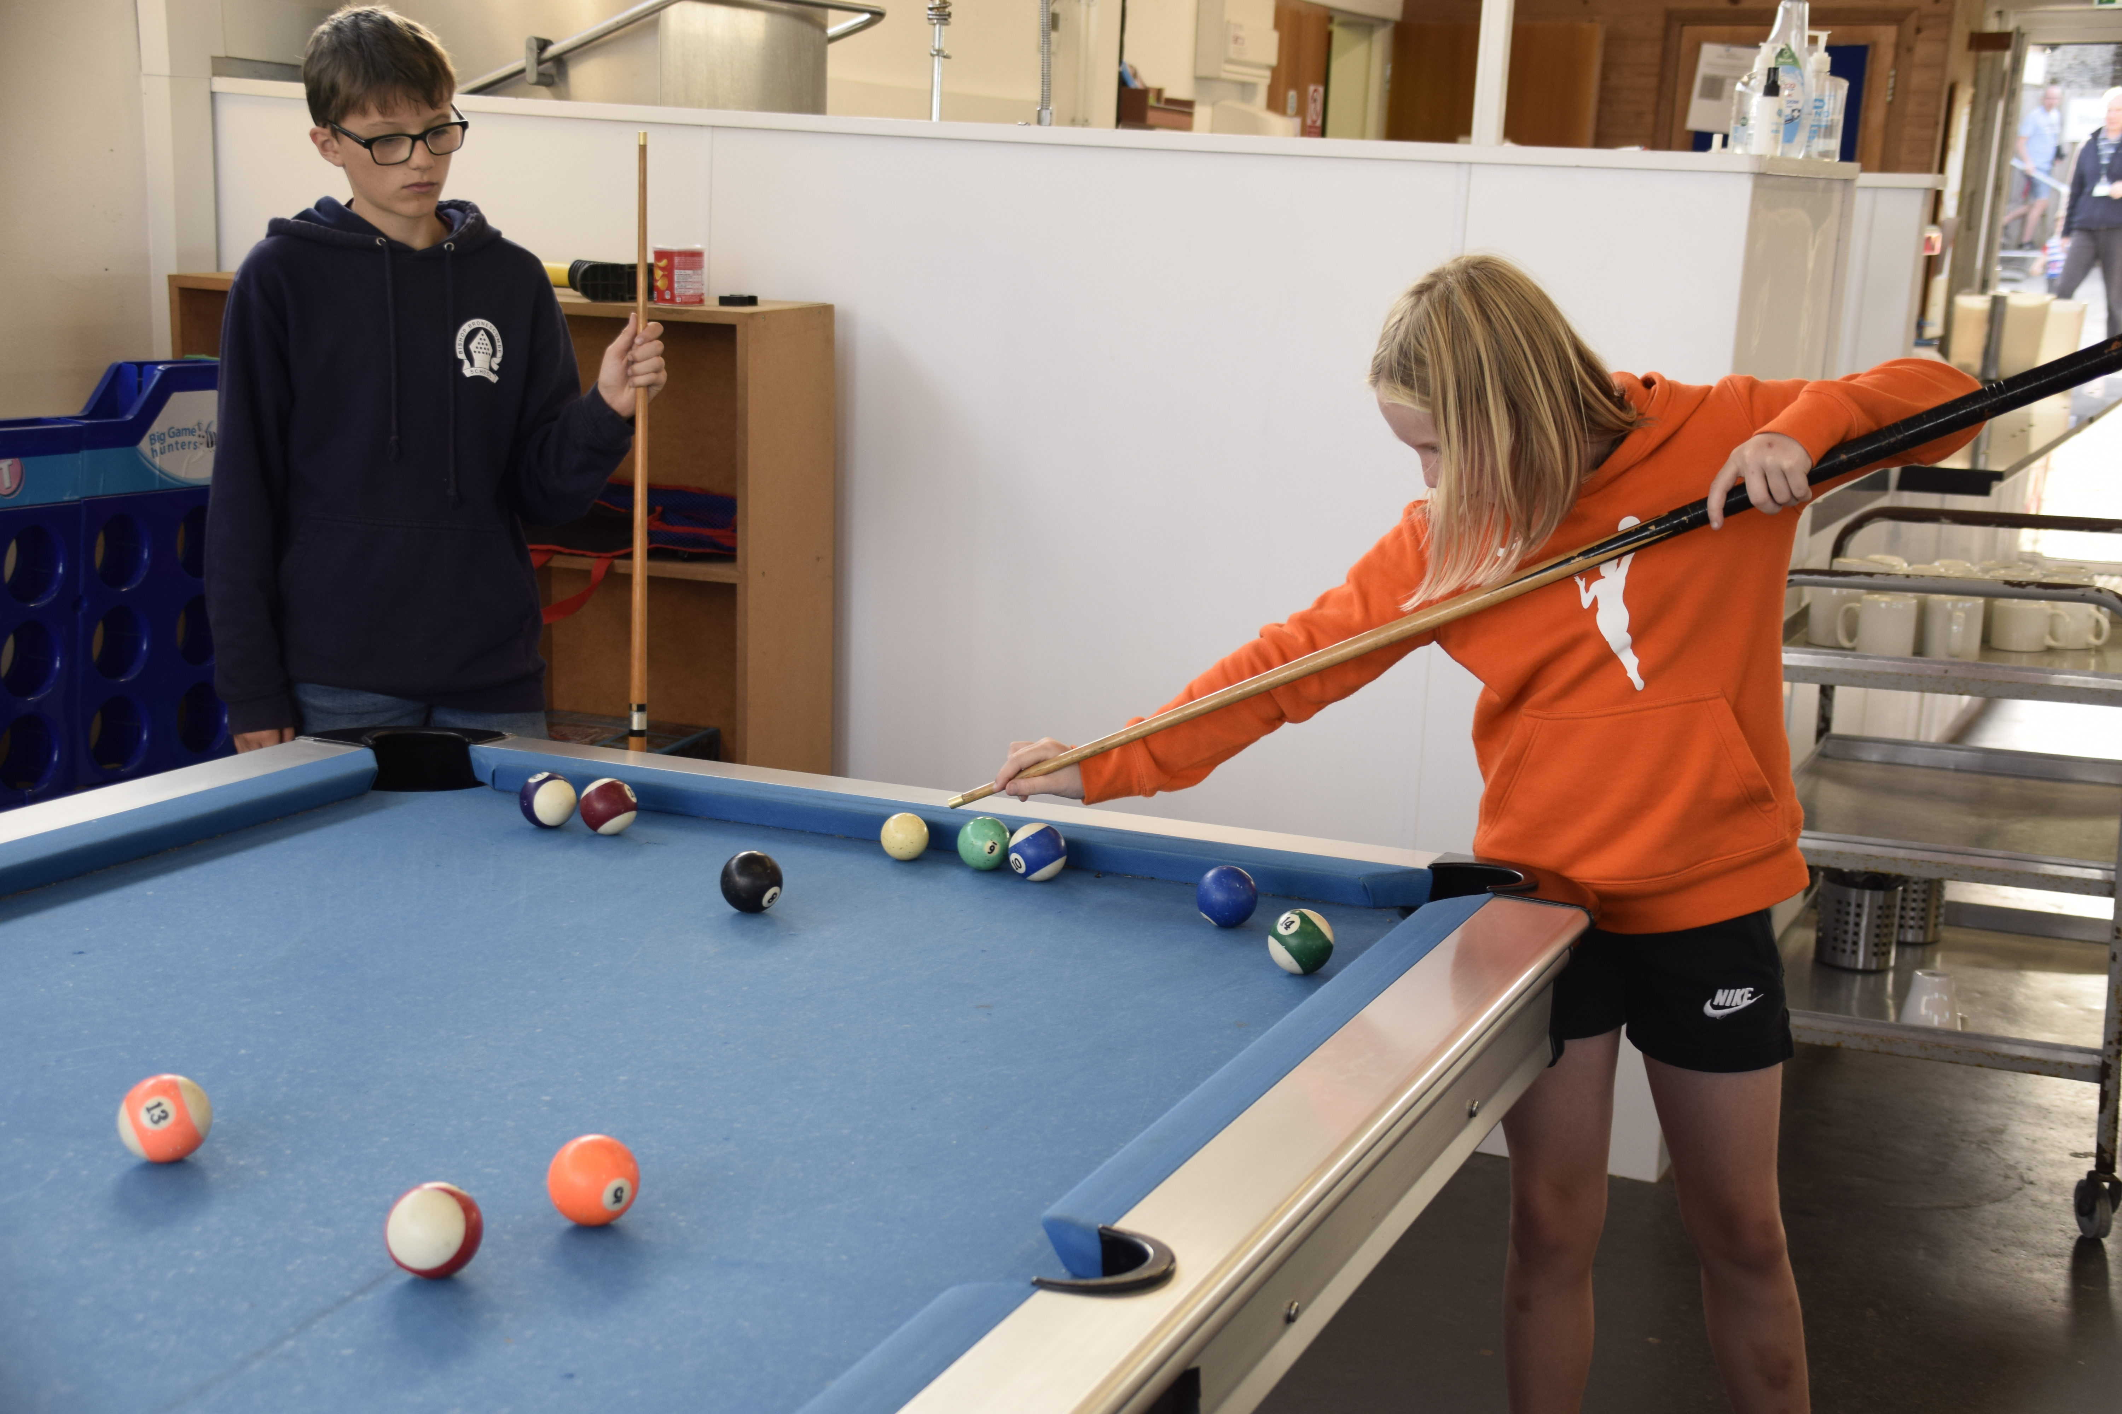

Slide 19
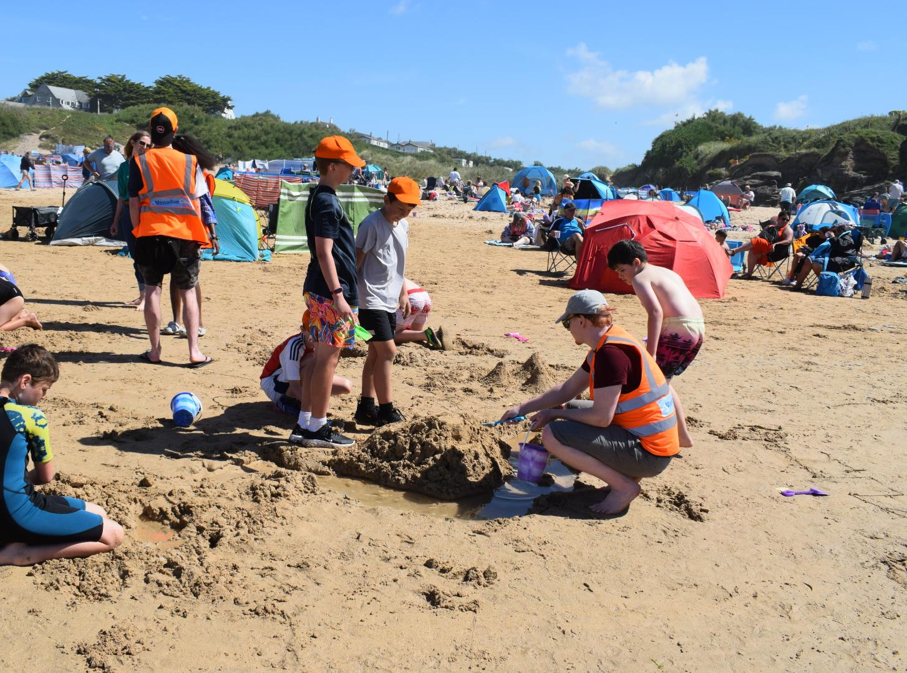

Slide 20
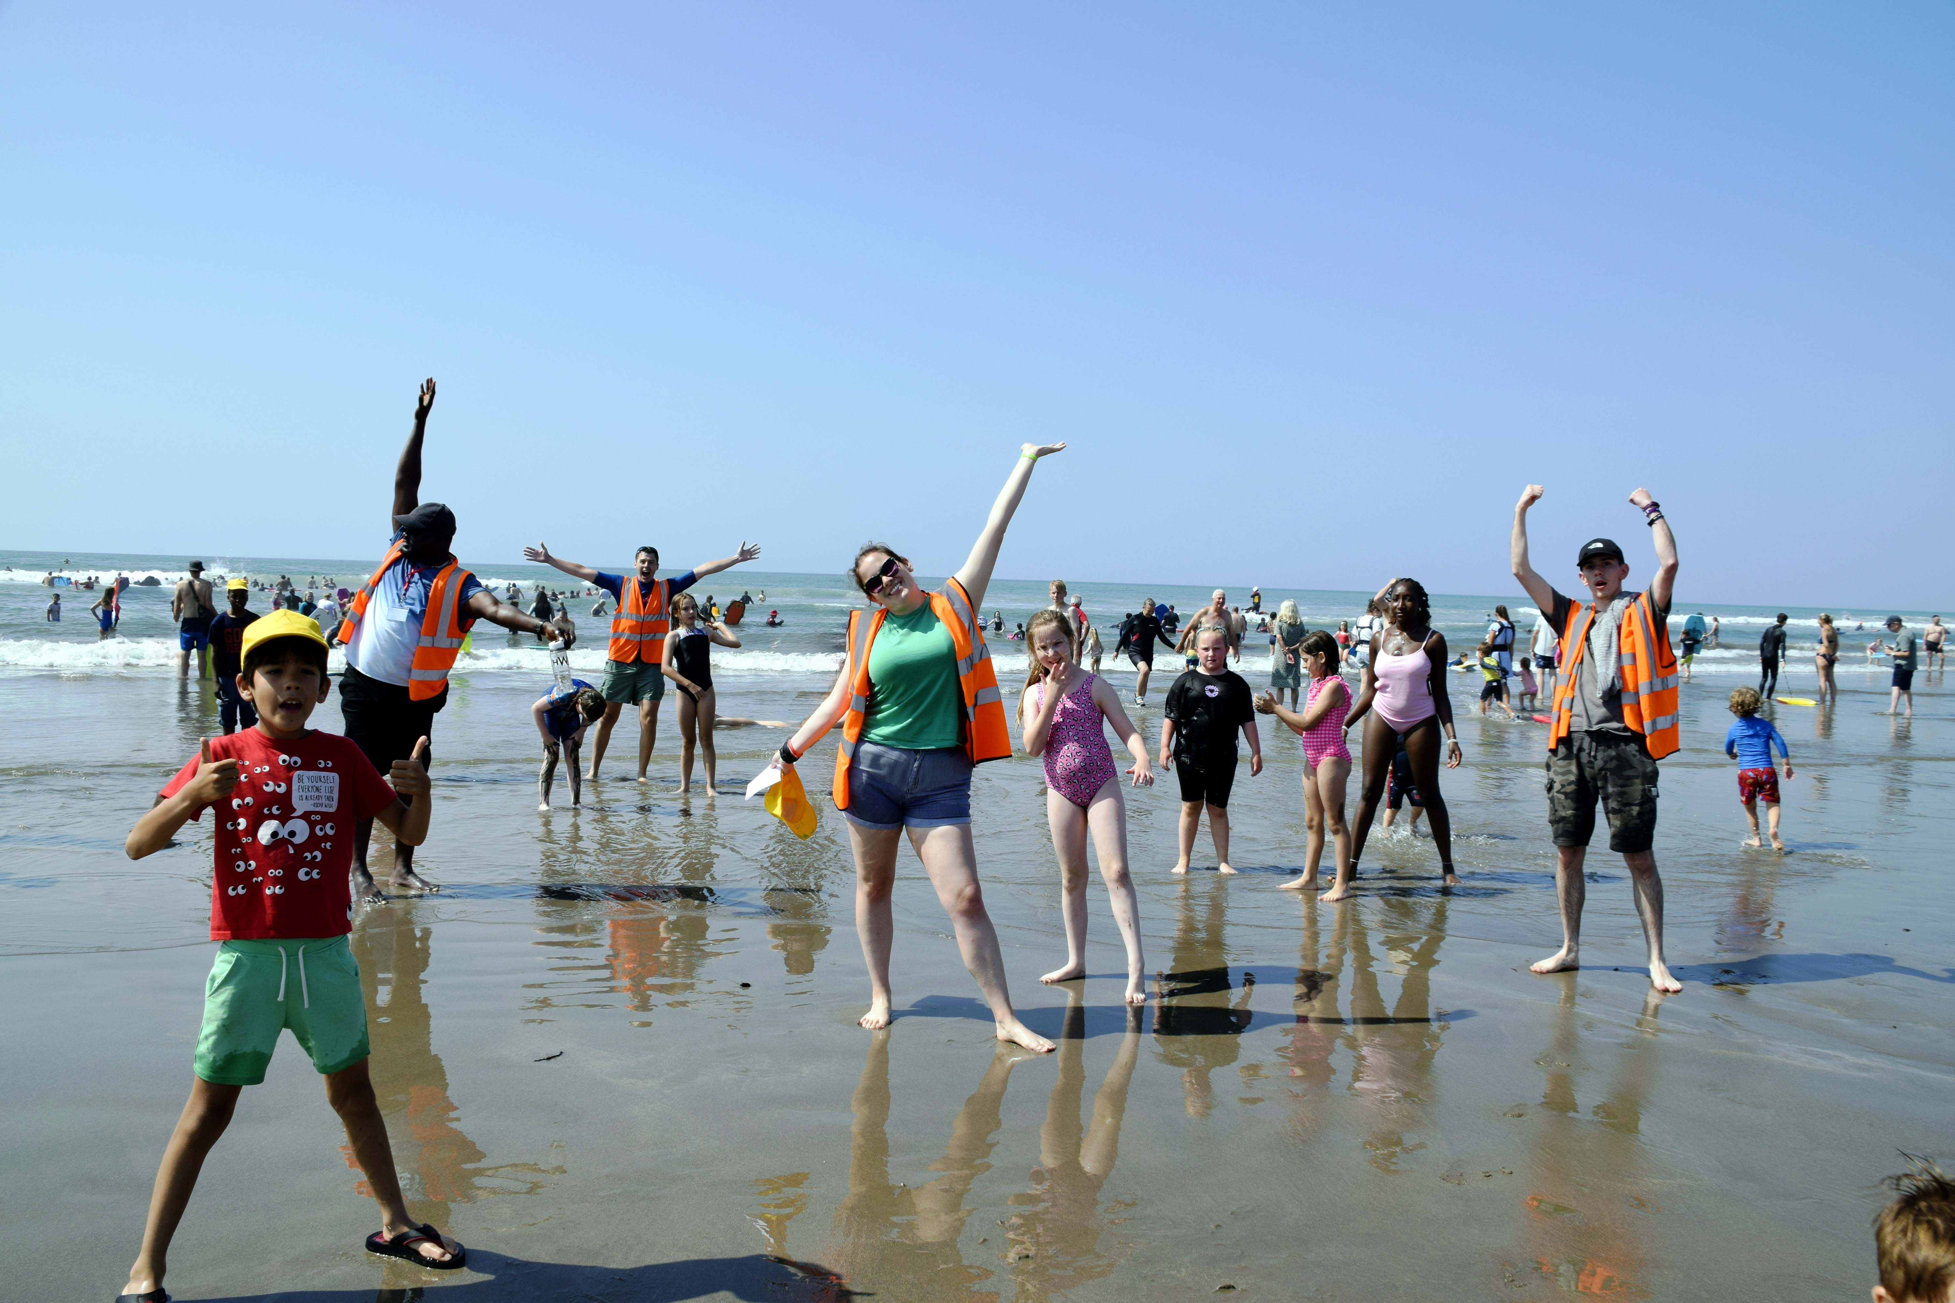

Slide 21
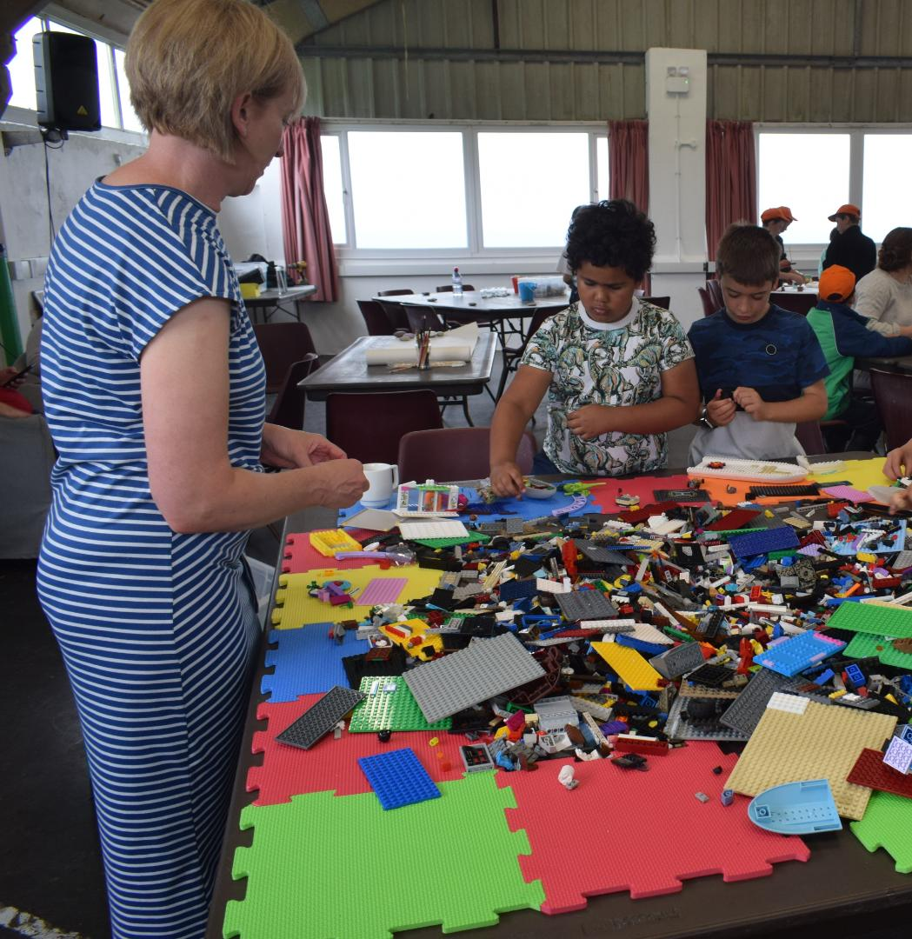

Slide 22
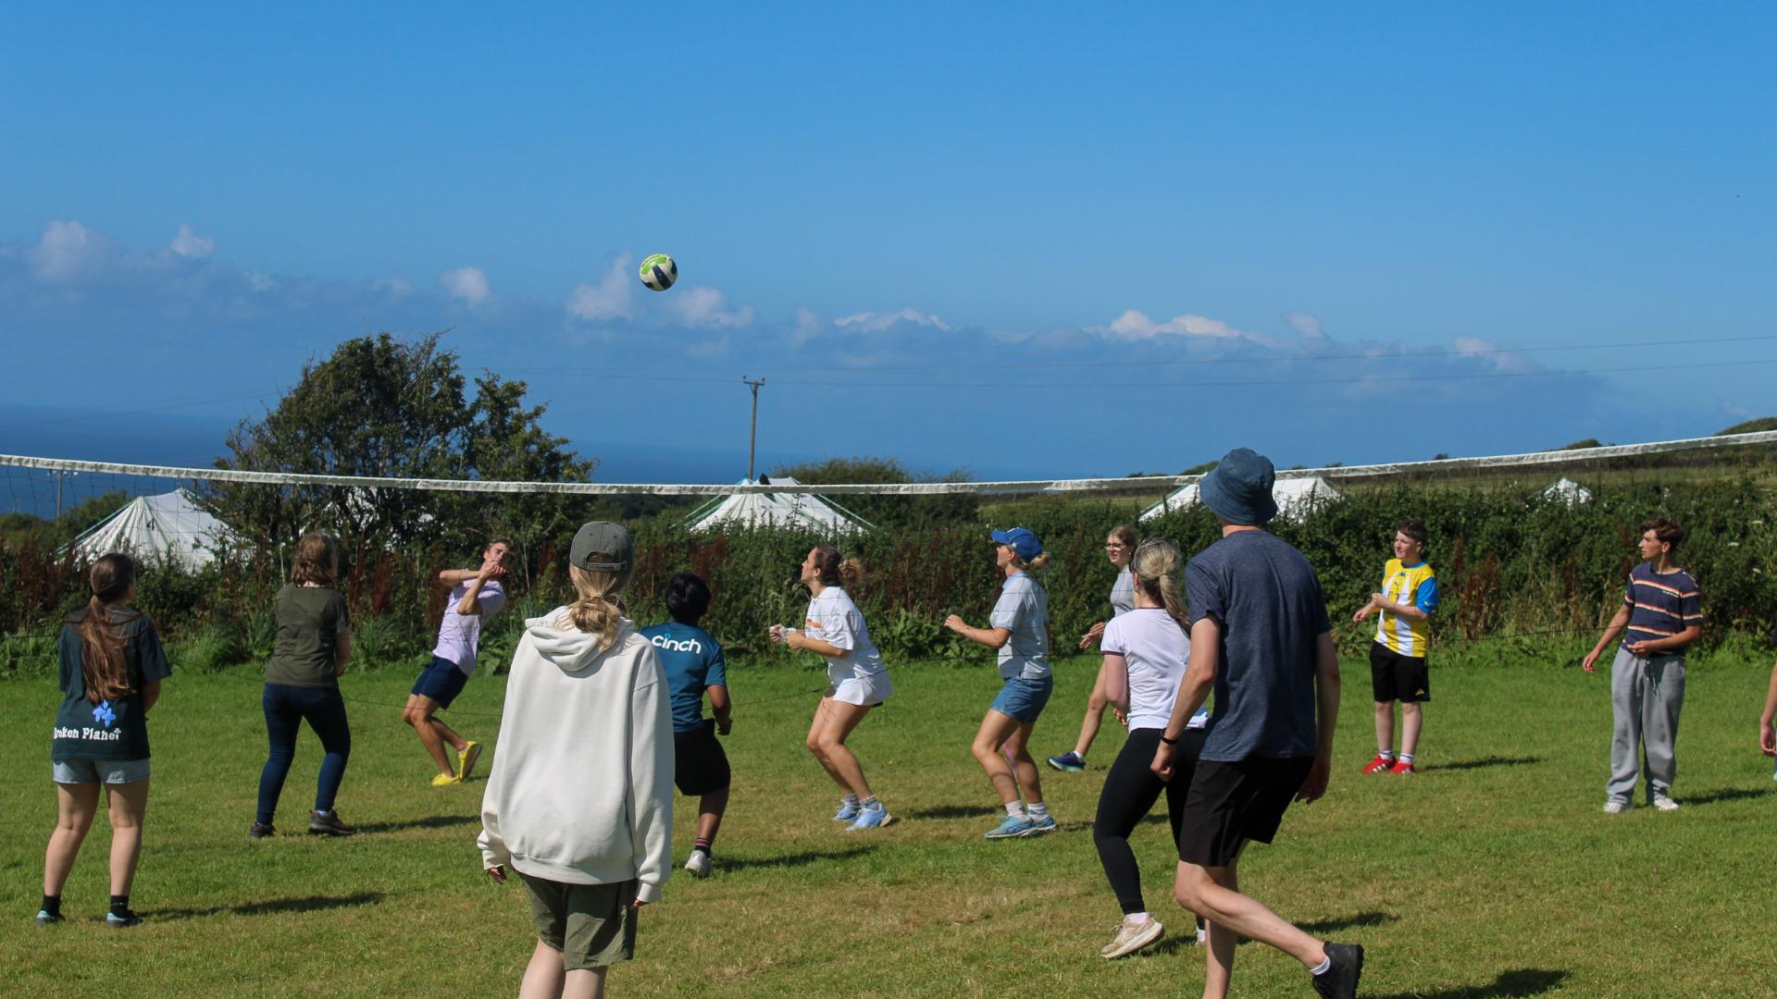
Click here
for video

Slide 23

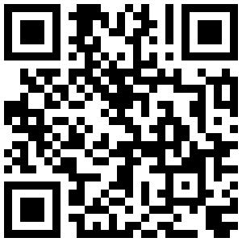

Equip & Discover: £176
£160 with £15 deposit before 31 Dec 2025
Explore: £127
£115 with £15 deposit before 31 Dec 2025

